Slide 1
13 Original Colonies

Slide 2
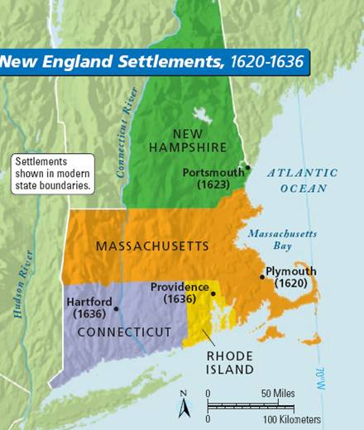
NEW
ENGLAND
COLONIES

Slide 3
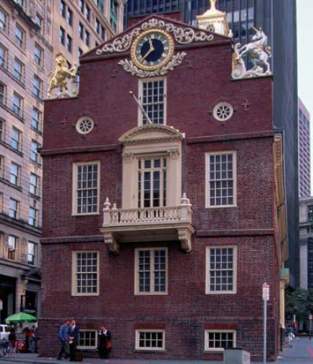
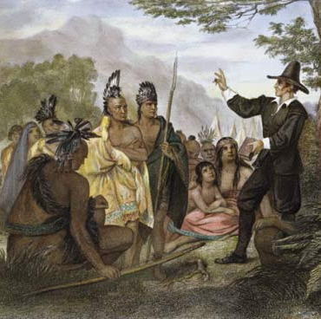
Massachusetts
People: Puritans/ Native Americans
Climate and Geography: fertile soil, rich pastures for cattle, lots of forests for timber. Humid summers, cold winters.
Economy: Raised food for families and local trade, trapped fur, forested lumber, and participated in shipping.
Religion: Puritans. Kingdom of God on earth, very religious.
Government: Ruled by Ministers who get their authority from God.

Slide 4
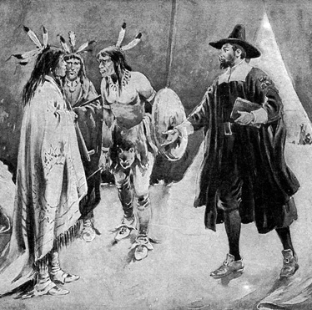
Rhode Island
People: Many fled here from Mass. Bay Colony to worship as they wanted. Some rich families who had large farms worked by slaves.
Climate and Geography: Land too poor for agriculture. Large bays were good for shipping. Cold Winters. Humid summers.
Economy: Large cattle and dairy farms. Otherwise, farms were small. SHIPPING. Also, slave trading centers.
Religion: founded for Religious freedom and had lots of religions.
Government: Ruled by an elected Governor and a general assembly that could make laws for the colony.

Slide 5
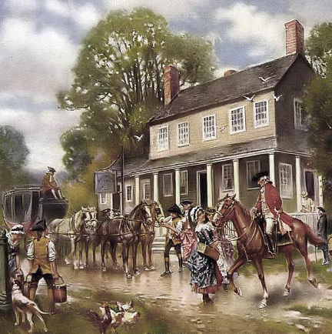
New Hampshire
People: Settlers wanting religious freedom. Migrants from other colonies.
Climate and Geography: Cold winters, good natural harbors.
Economy: Fur trading, ship building, and fishing.
Religion: Many different religions.
Government: Royal providence (meaning direct control from the crown). At first English Royalty chose the leaders but eventually leaders were elected.

Slide 6
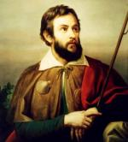
Connecticut
People: Settled by the Dutch and the Swedes. Puritans also settled there. Many slaves and indentured servants were also brought to this colony.
Climate and Geography: Good soil but most farms were small. The ground was hilly and covered with forests.
Economy: Fishing, whaling, and trading were all ways to make money. Small family farms. Foresting and raising cattle.
Religion: Puritan. Most settlers came from Mass. Bay.
Government: World’s first written constitution. One representative from each town controlled by a governor.

Slide 7
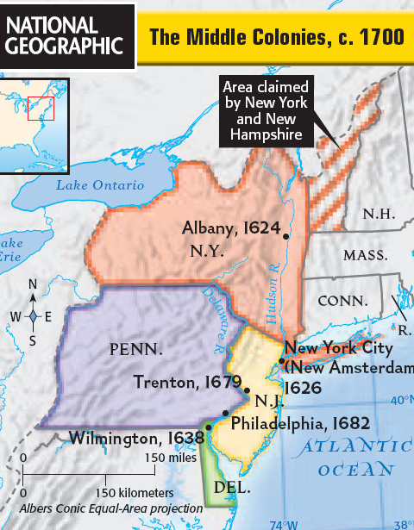
Middle
Colonies

Slide 8
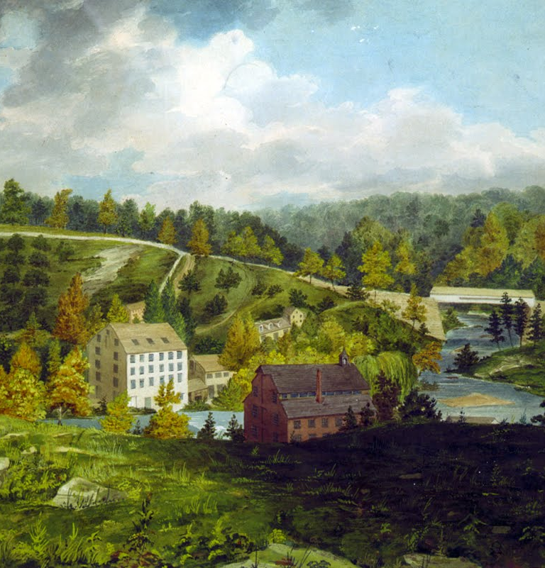
Delaware
People: Settlers were English, Dutch, and Swedish.
Climate and Geography: Lots of fertile land that was good for farming. Lots of forests used for lumber.
Economy: Some jobs in Delaware were shipbuilding, ironworks, trading, fishing, and lumber and timber industries.
Religion: Tolerant of many different religions.
Government: Controlled by a council who elected the governor.

Slide 9
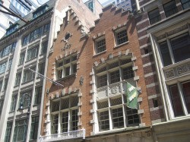
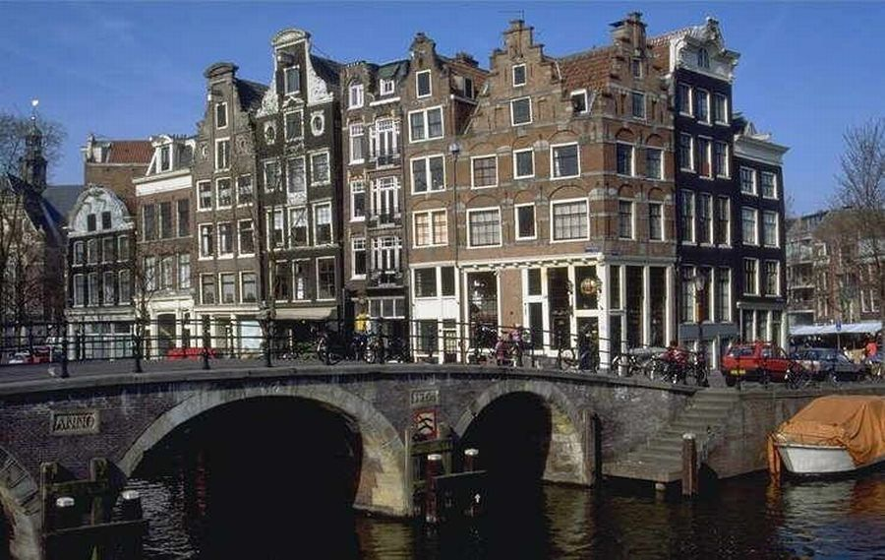
New York
People: Dutch (looking for religious freedom). Indentured servants, slaves, and Native Americans.
Climate and Geography: Cold winters and hot, humid summers. Rocky soil but good for farming once rocks were cleared. Swampy near rivers.
Economy: fur trapping, lumber trading, shipping, and the slave trade. Some mined for Iron and others farmed, after they cleared land.
Religion: Many faiths and considerable religious freedom.
Government: Run by a governor appointed by the King. Little self government.

Slide 10
Pennsylvania
People: English Quakers. Other Protestant religions fleeing Europe came to Pennsylvania. Slaves 20% of the population.
Climate and Geography: Rolling hills and fertile soil. Humid in the summer, cold in the winter.
Economy: most were farmers who raised corn and wheat. Some colonists made money clearing farmland and selling timber.
Religion: Strong tradition of religious tolerance.
Government: Had their own form of self government.

Slide 11
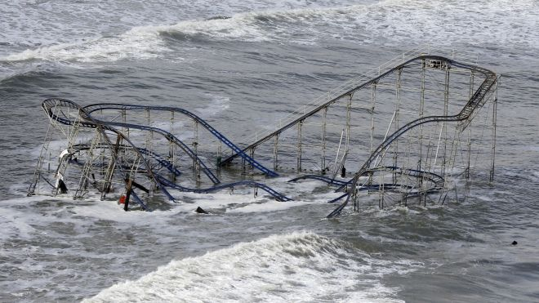
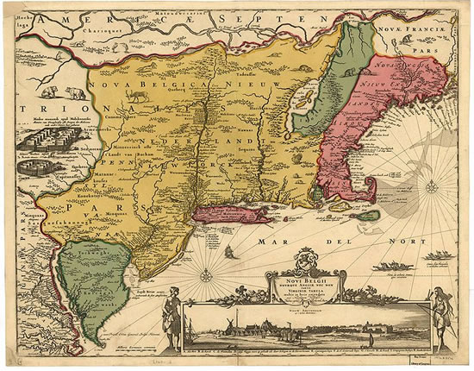
New Jersey
People: Colony promised many benefits and migrants of all different religions came to settle here.
Climate and Geography: Land is flat close to the ocean. As you move farther west the land becomes more mountainous. Cold winters and hot humid summers. All affected by the Atlantic Ocean.
Economy: Agriculture here centered around breeding live stock. Mining was also big in New Jersey.
Religion: Wide variety of religions represented.
Government: Run by an elected governor and council.

Slide 12
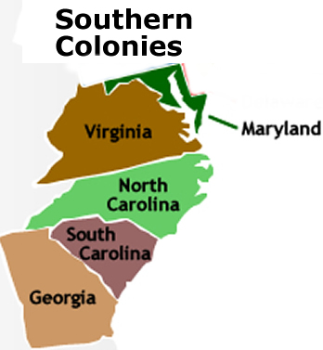

Slide 13
Maryland
People: Most were Catholics however there were Protestants fleeing religious persecution.
Climate and Geography: flat and fertile land. Lots of rain and snow in the winter.
Economy: farmed a variety of plants. They were also involved in the lumber business, shipping, fishing and raising cattle for beef and milk.
Religion: Mostly Catholics but they were tolerant of other religions.
Government: Colonists allowed to govern themselves.

Slide 14
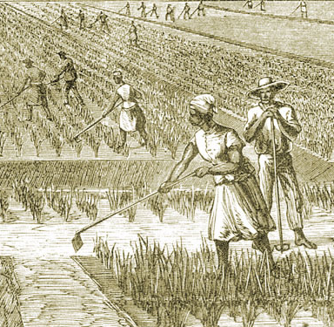
Georgia
People: Settlers were debtors from and English prisons. Some settlers were seeking religious freedom and cheap land but for the most part, it was a debtors colony.
Climate and Geography: fertile swamps where farmers could grow rice and Indigo. The western part of the colony had lots of mountains and forests.
Economy: Large farms growing cash crops using slavery. If you didn’t own a plantation, you could work as a skilled craftsman such as a shoemaker, tailor, brick maker, or blacksmith.
Religion: Many came to escape religious persecution but there isn’t a dominant religion. Religiously tolerant.
Government: Elected government.

Slide 15
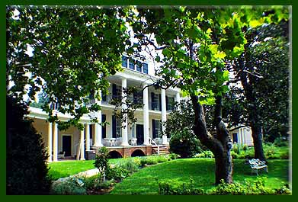
North Carolina
People: Eight proprietors were given the right to settle North Carolina. Had a far more diverse population than those living in the North. Had a large number of slaves to work on plantations.
Climate and Geography: The temperature is more mild than other colonies. Good farm land. The farther west you go, the more mountains you find.
Economy: Agriculture here was solely based on plantations. The plantations grew rice, indigo and tobacco.
Religion: Wide variety of religions represented in the colony.
Government: It was a proprietary colony run by the owners (proprietors)

Slide 16
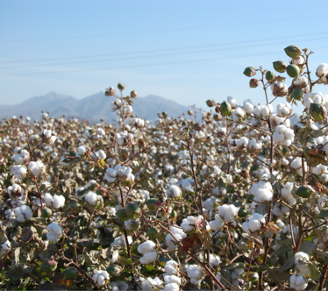
South Carolina
People: Native Americans were slaves before Africans were used. Europeans fleeing religious persecution.
Climate and Geography: Long growing season for crops. Lots of swamps which lead to settlers getting diseases.
Economy: Swamps were good for growing rice. Grew other cash crops like cotton, tobacco and Indigo. Slave trade also made lots of money during this time. Known for its silversmiths and furniture makers.
Religion: Great religious freedom.
Government: At first, England controlled every thing but over time colonists were allowed to elect their own officials.

Slide 17
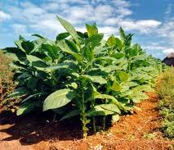
Virginia
People: First settlers were English men who were apart of the Virginia Company. Many people were also skilled at various trades such as shoemakers, brick layers, and tailors.
Climate and Geography: Lots of rain and fertile soil made excellent farm land. Quiet bays were perfect for shipping. Western part of the colony had lots of trees and forests.
Economy: Tobacco grew well in Virginia and made lots of money so large plantations run by slave labor started popping up to help meet demand.
Religion: The Church of England was the official religion of Virginia.
Government: Virginia House of Burgesses. Elected officials.

