Slide 1
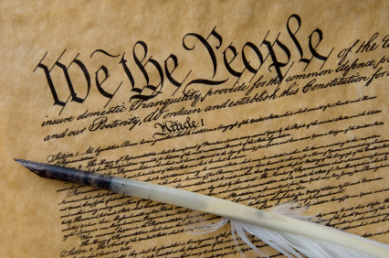
Constitution

Slide 2
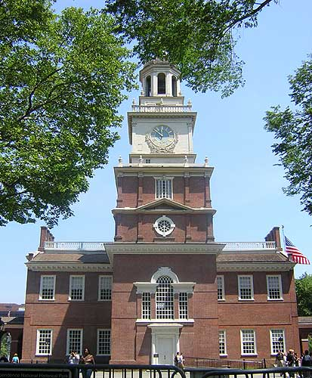
Division
Several Issues divided the Convention, which are…
Delegates met at the Constitutional Convention in the same place the Declaration of Independence was written.
Delegates are people from each colony who have been chosen by the people in the delegates colony.
The Delegates are meeting because the new government has serious problems!
Rewrite or start over?
Representation?
Slavery?

Slide 3
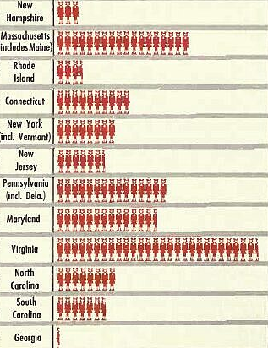
First Problem… Representation
STOP!
Virginia Plan
Written by James Madison
Nicknamed Large State Plan
Representatives would be chosen based on population
Population- how many people live in your state.
Small states disagree with this plan. They argued it would give the large states too much power.

Slide 4
First Problem… Representation
New Jersey Plan
STOP!
Under this plan, each state would have equal number of votes.
This would give the smaller states an equal voice in national government.
Large states didn’t like this plan because it thought it gave the small states more influence than they really should have.

Slide 5
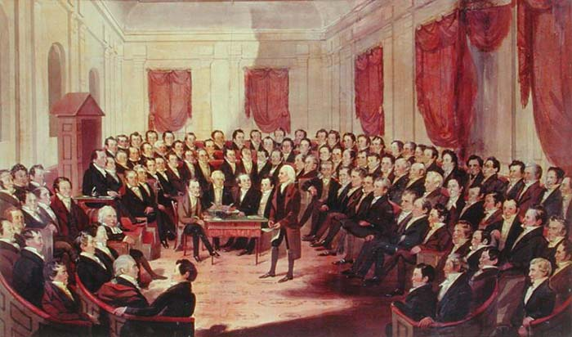
The Great Compromise
After a MONTH of debating, no one could reach an agreement about what to do!
Senate
House of Representatives
Every state, regardless of its size, would have an equal vote
Each state would have representatives based on their population.
Make laws

Slide 6
More Compromises
Southern delegates wanted slaves to be counted in their population
WHY?
They would get more representatives in the House.
Northern delegates disagreed. The slaves got no rights of citizenship, so why should they be counted in the total number of citizens? Plus it made them less powerful!
VS.

Slide 7


3/5 Compromise
Northerners and southerners agreed to count 3 out of every 5 slaves into the population for representation.
People get angry about 3/5 compromise…
Why?

Slide 8
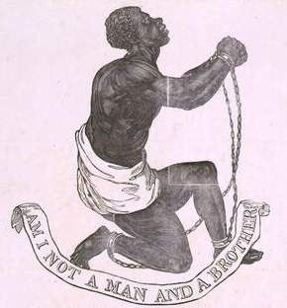
Slavery
Both North and South argued about Slavery. The North wanted to stop the slave trade and put a time limit on importing slaves. Twenty years.
The South NO WAY! We aren’t even going to discuss it. There were definitely no compromises with slavery so they just ignored the issue
(They are at a stand still until the Civil War!)

Slide 9
Preamble
We the people of the United States, in order to form a more perfect union, establish justice, insure domestic tranquility, provide for the common defense, promote the general welfare, and secure the blessings of liberty to ourselves and our posterity, do ordain and establish this Constitution for the United States of America.

Slide 10

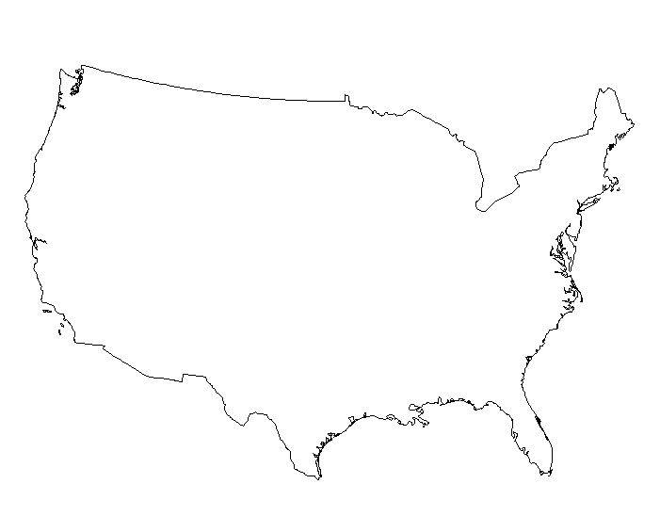
Federalism- Shared power between Nation and State
Shared Powers
Federal Government
State
Government
Declare War
Admit New States
Coin Money
Establish Post Offices
Pass Taxes
Borrow money
Create banks
Establish and Maintain schools
Marriage laws
Provide for public safety

Slide 11

3 Branches of Government
Executive
Enforces the law
Legislative
Judicial
Makes the law
Interprets the law

Slide 12


Checks and
balances
Keeps one branch from being too powerful.

Slide 13
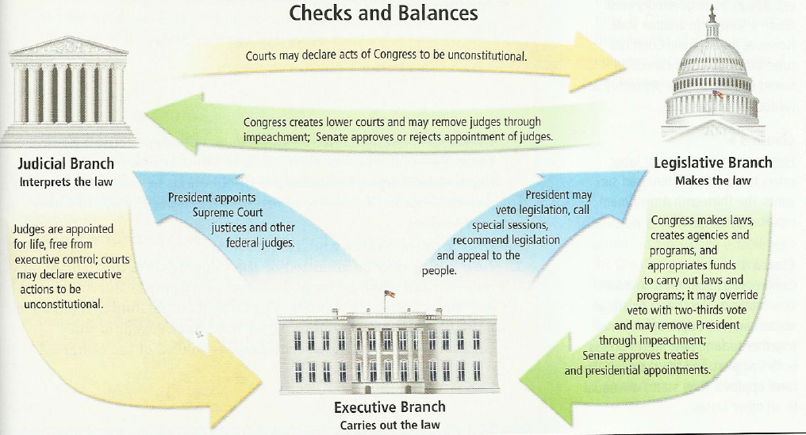

Slide 14
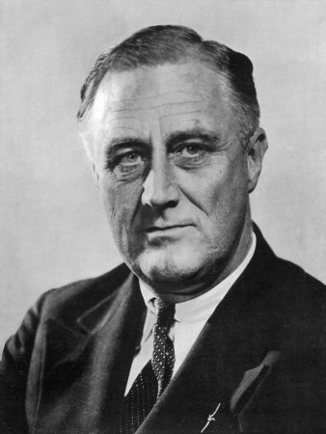
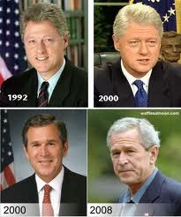
Executive Branch
Serves for 4 years and can be elected for two terms only
Before 1951, a President could serve for an unlimited number of terms

Slide 15
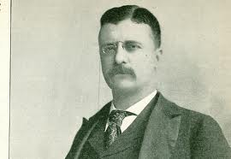
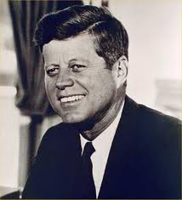
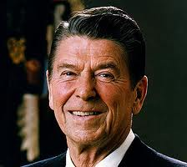
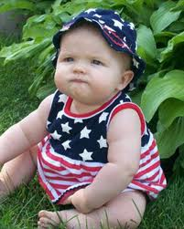

To become President, you must:
Have been born in the U.S.
Have lived in the U.S. for the last 14 years
Be at least 35 years old

Slide 16
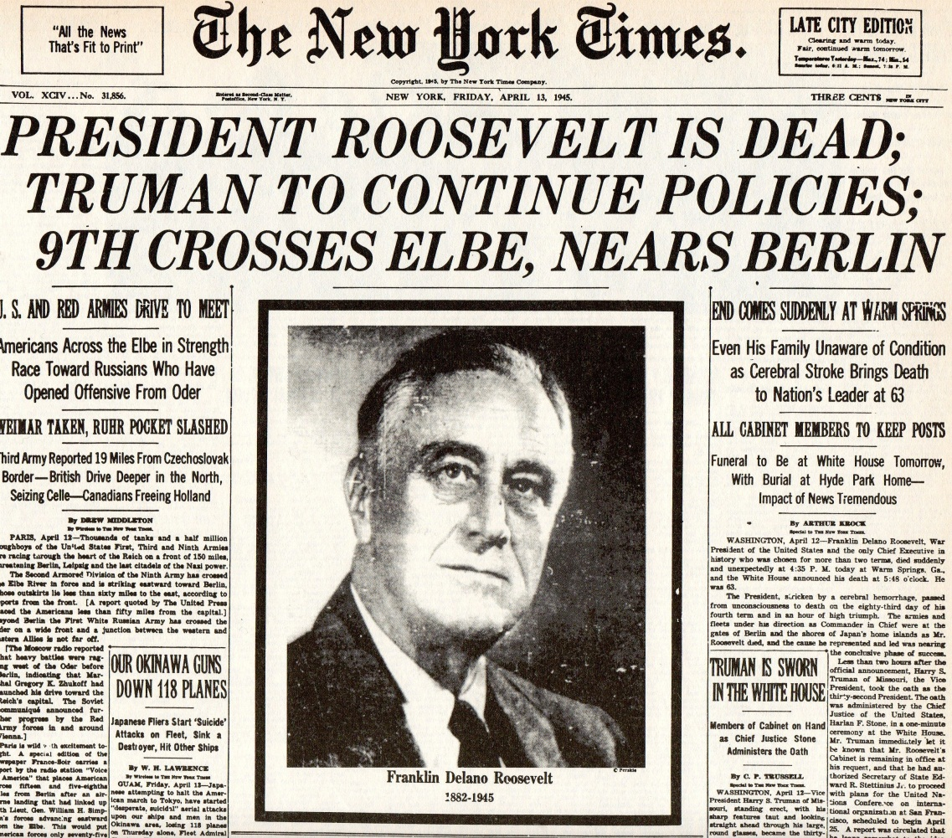
What About the VP?
The VP takes over if the President dies
Vice President | Became President | Days as Presidnt | Re-election
John Tyler | Harrison died of pneumonia in 1842 | 1,430 | Didn't run for President
Millard Fillmore | Taylor died in1850 from illness | 969 | Lost nomination.
Andrew Johnson | Lincold assassinated in 1865 | 1,419 | Failed to win the nominationin1868
Chester A. Arthur | Garfield was assassinated in 1881 | 1,262 | Was not nominated
Theodore Roosevelt | McKinley was assasinated in 1901 | 1,267 | Elected to a full term. Did not run in 1908. Was defeated in 1912
CalvinCoolidge | Harding died of a heart attack in 1923 | 580 | Elected to a full term. Did not run for a second term.
Harry S. Truman | Roosevelt died of a cerebral hemorrhage in 1945 | 1,379 | Elected to a full term but did not run again.
Lyndon B. Johnson | Kennedy assassinated in 1963 | 425 | Elected to a full term but didn't seek relection in 1968
Gerald R. Ford | Nixon resigned in 1974 | 895 | Lost election ot Jimmy Carter in 1976

Slide 17
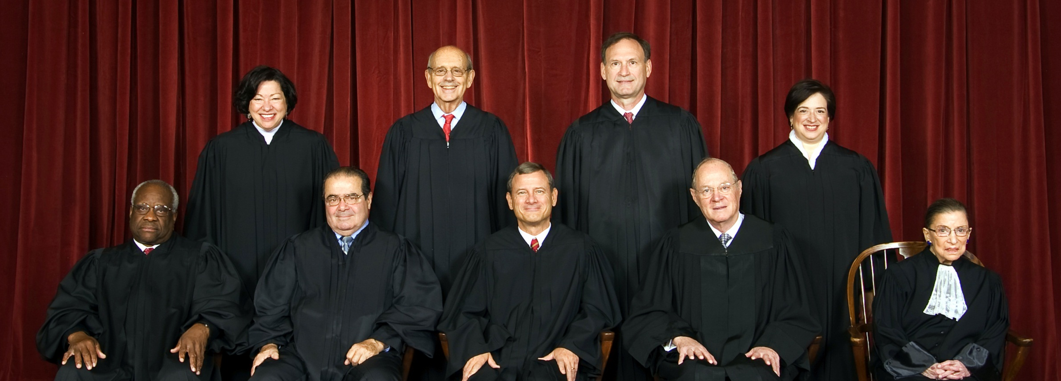

Judicial Branch

Slide 18
What do they do?
Interpret the Constitution
Judge federal crimes (like forging money or spying on other countries)
They don’t make laws or enforce them, they analyze them and make sure they are constitutional.

Slide 19
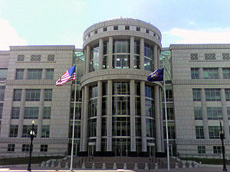
Judicial Branch
Supreme Court justices serve until they die or retire
In addition to the federal courts, each state has a state court, including a state Supreme Court
  Most cases are decided within the state system because most crimes are not federal crimes.

Slide 20
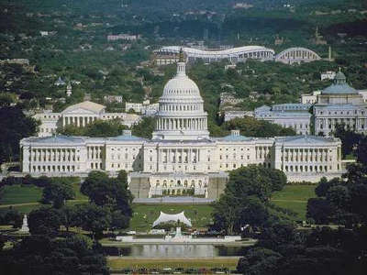

Legislative Branch

Slide 21
Legislative Branch
Their job is to MAKE LAWS
House (435)
Senate (100)
You must be 25 years old to run and have lived in the country for seven years.
Serve for two years only.
Impeach the president. Andrew Johnson(1868) and Bill Clinton(1998) were impeached. Richard Nixon(1974) resigned instead of facing impeachment. Serve for two years.
You must be at least 30 years old and have lived in the country for nine years.
Senators serve for 6 years.

Slide 22
House of
Representatives
BILL
Senate
LAW

Slide 23
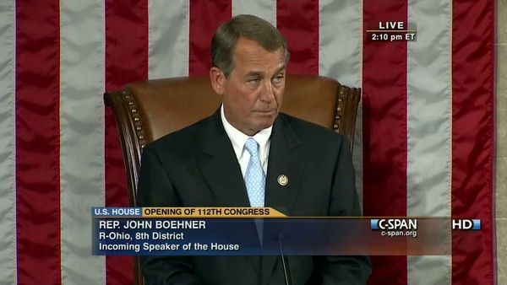
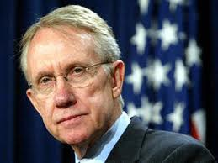
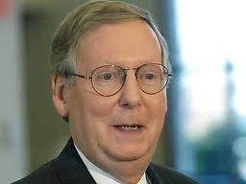
Who is in Charge?
House Speaker
Senate
Majority Leader
  Harry Reid
Minority Leader
  Mitch McConnell
The House Speaker is the head of the House of Representatives. If the Pres. and VP die, the House Speaker is next in line.

Slide 24
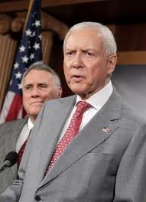



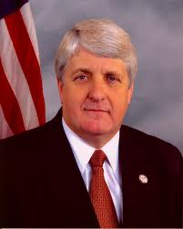
Who Represents Us?
Senators
Representatives
Jim Matheson - D
Jason Chaffetz - R
The number of Representatives is based on your states population.
Mike Lee
Orin Hatch
Each State has 2 Senators
Rob Bishop - R

Slide 25
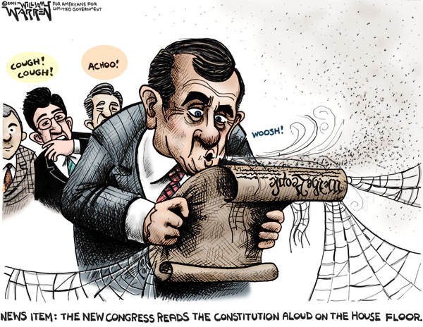
How do We Change the
Constitution?
2/3 of the Senate and House of Representatives
PLUS ¾ of all states
The President has NO say at all

Slide 26
President and Congress
President and Congress must work together!
This is difficult when Congress and the President are of different parties.
Although Congress passes laws, the president can ask members of Congress to pass or reject certain bills.
The President also has the power to veto, or cancel, certain laws that Congress passes.
Congress can override a veto, but that is difficult.
“What a president says and thinks is not worth five cents unless he has the people and Congress behind him. Without the Congress I’m just a six feet four Texan. With Congress, I am the President of the United States in the fullest sense.”

