Slide 1
Interest Groups in North America
Spanish
French
English
Dutch
Wampanoag
Powhatan

Slide 2
What did each group compete over?
Monopoly on Trade
Beaver Skins, Wampum, Fishing rights, etc.
LAND
-Country with the most land would make the most money.

Slide 3
Who had best relations with Native Americans?
The French
Why?
Because there weren’t as many of them and they needed the help of Native Americans to survive and trade.

Slide 4
What is a Colony?
A body of people who settle far from home but maintain ties with their homeland; inhabitants remain nationals of their home state but are not literally under the home state's system of government.

Slide 5
What is a Charter?
Document that gave colonies the legal rights to exist. A charter is a document bestowing certain rights on a town, city, university or institution.

Slide 6
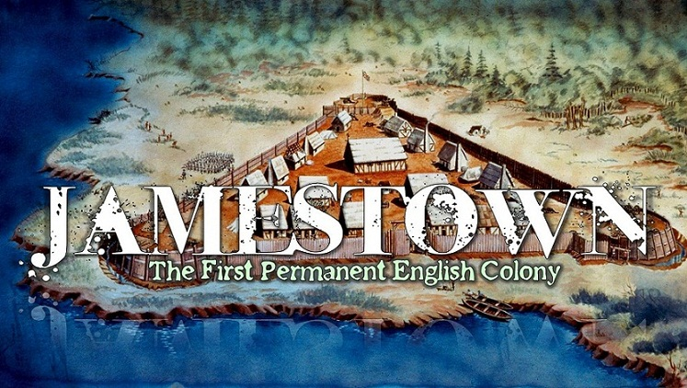

Slide 7
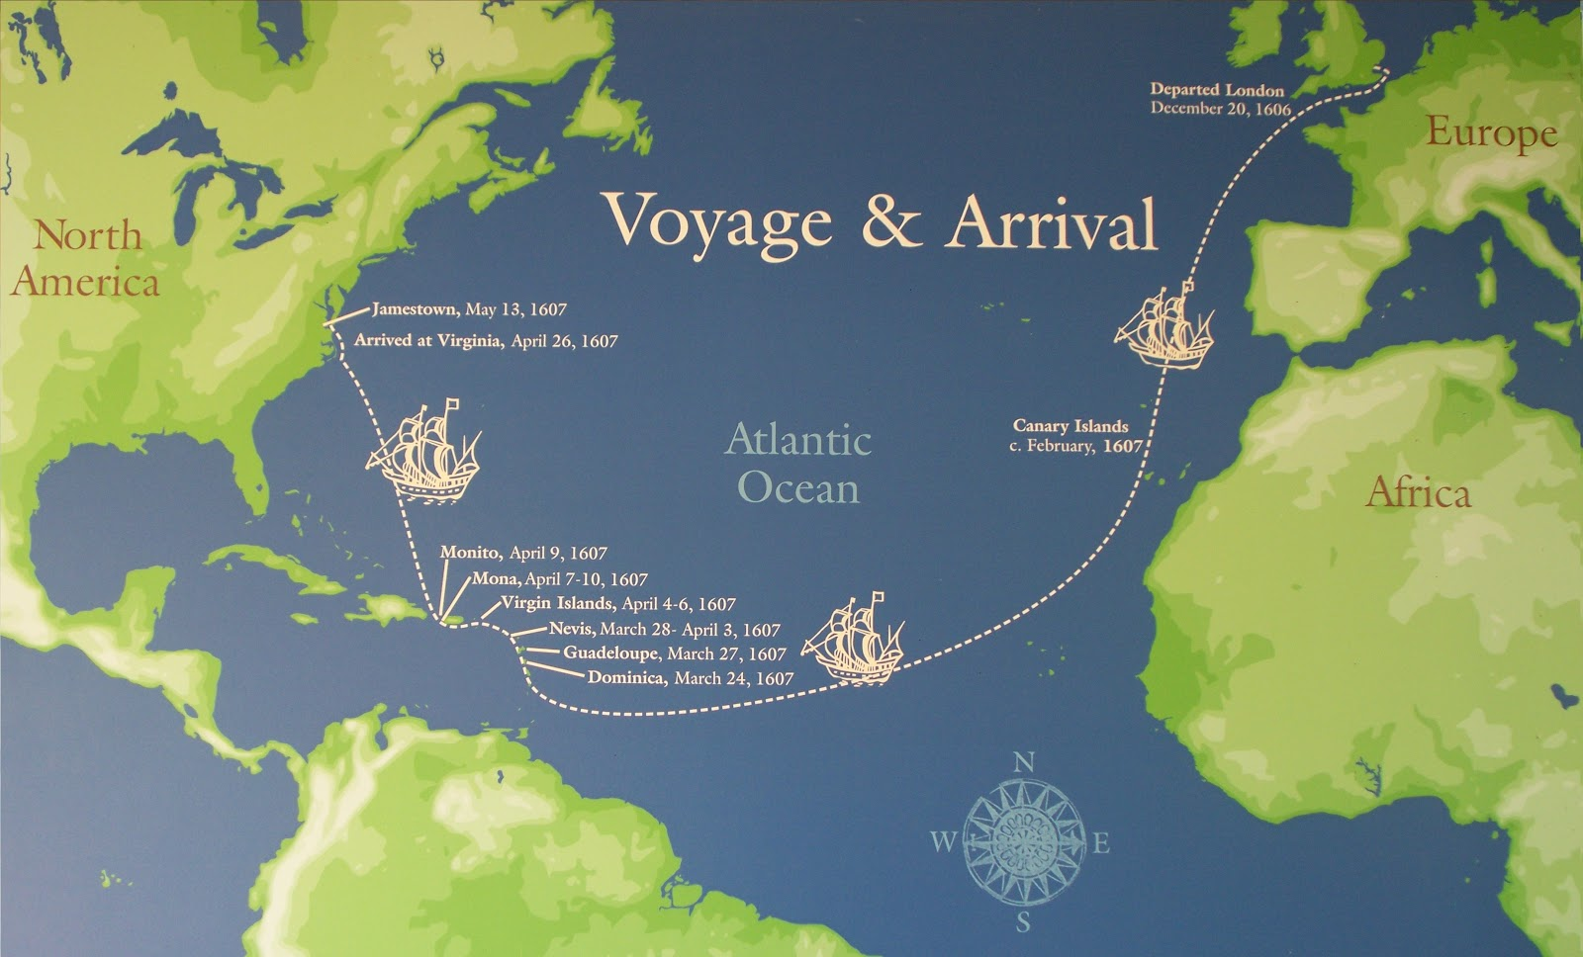
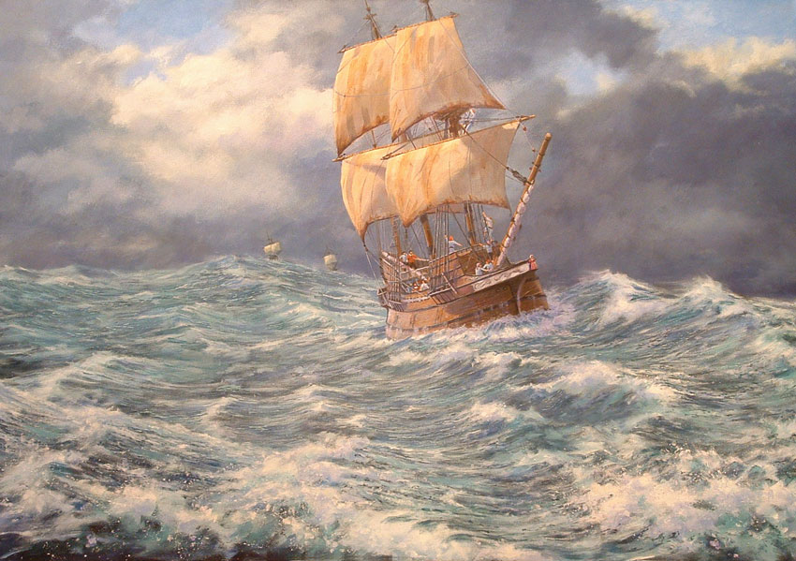
Atlantic Ocean: A Barrier to Bridge

Slide 8
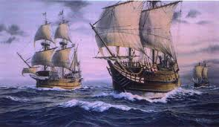
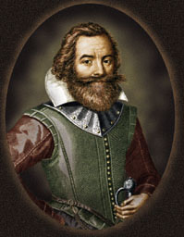
Who were they?
The Englishmen who set sail on the Susan Constant, Godspeed, and Discovery numbered 144. The sailors returned to England.
John Smith described the remaining 105 men and boys as “the first Planters” of the colony.
Susan Constant, Godspeed and Discovery
Captain John Smith

Slide 9
Why Did They Come?
England hoped to find silver and gold in America.
An American Settlement would furnish raw materials that could not be grown or obtained in England, while opening new markets for trade.
Jamestown was primarily an economic venture.

Slide 10
What Did They Do?
Original Settlers (May 14, 1607) at Jamestown, Listed by Occupation
What were the different occupations in Jamestown? List at least 5 of the occupations.
Which occupation was the fullest (had the most people)?
What do you think the fullest occupation was responsible for?
How do you think they hurt AND helped the colony?

Slide 11
Where Did They Settle?
James River

Slide 12
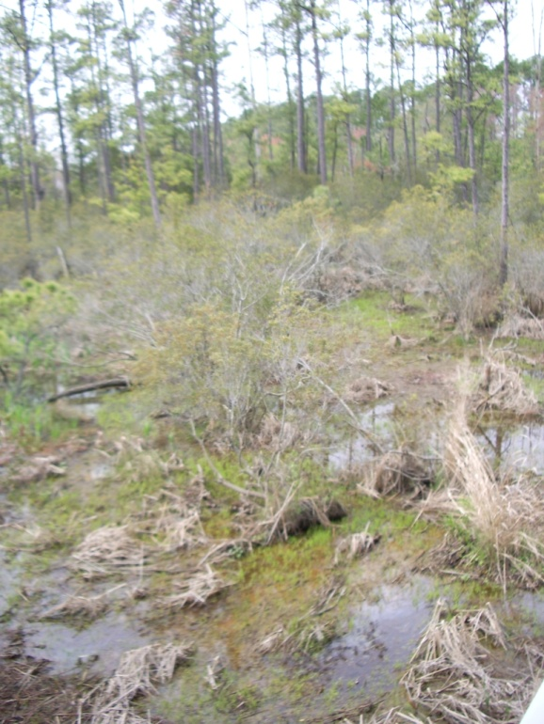
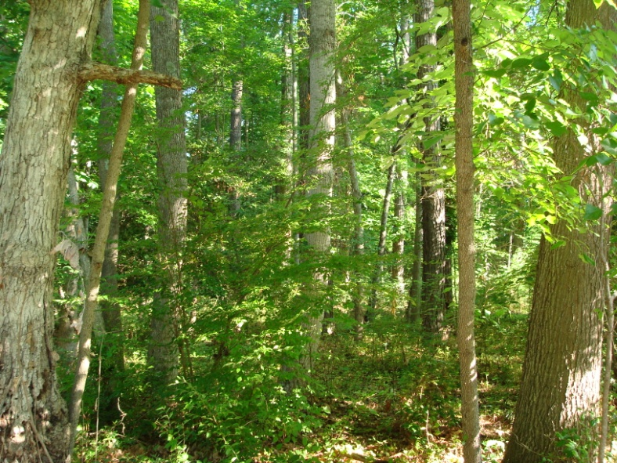
Region: Tidewater
How was Jamestown affected by its geographic
setting?
Forest
Swampland
Brackish Water
Marshland

Slide 13
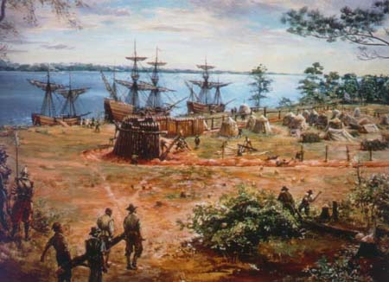
Picture Analysis: Give three examples from the picture that illustrate why the English chose Chesapeake Bay. Explain each example.

Slide 14
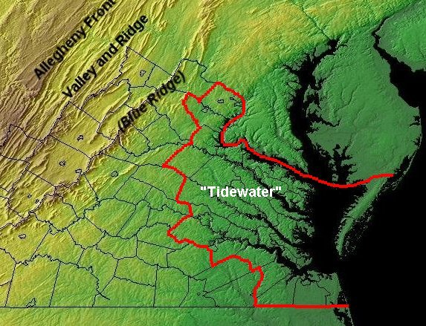
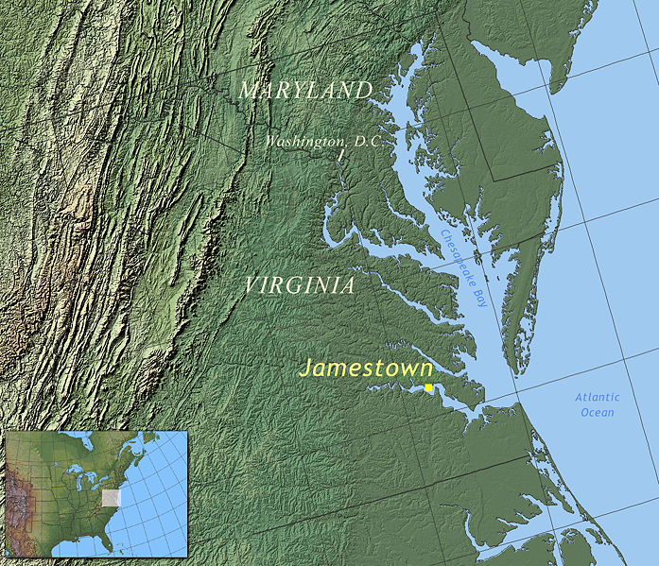
Location: Jamestown, the first successful English Colony
The Virginia Company landed in Chesapeake Bay on May 14th, 1607.
The site was chosen based on what it could provide:
1. Protection from the elements (ocean currents, storms, etc).
2. Protection from Spanish spies.
3. Deep water ways in which ships could easily navigate.
Tidewater
Region
Chesapeake Bay
“Great Shellfish Bay”
James River

Slide 15
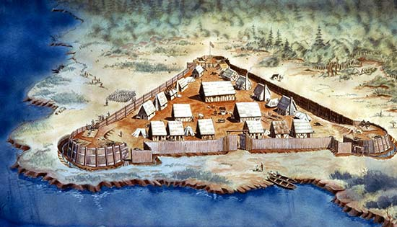
James Fort
Depiction of James Fort

Slide 16
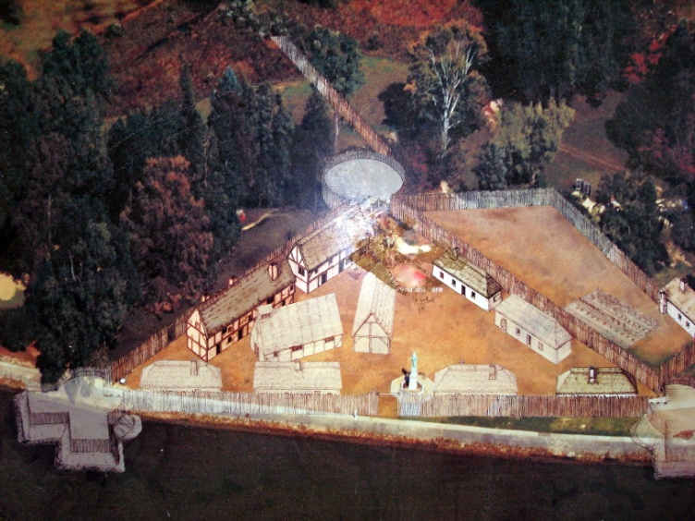
What Archeologists have found today

Slide 17
