Slide 2
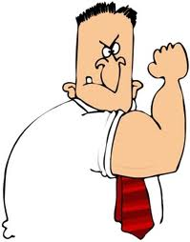
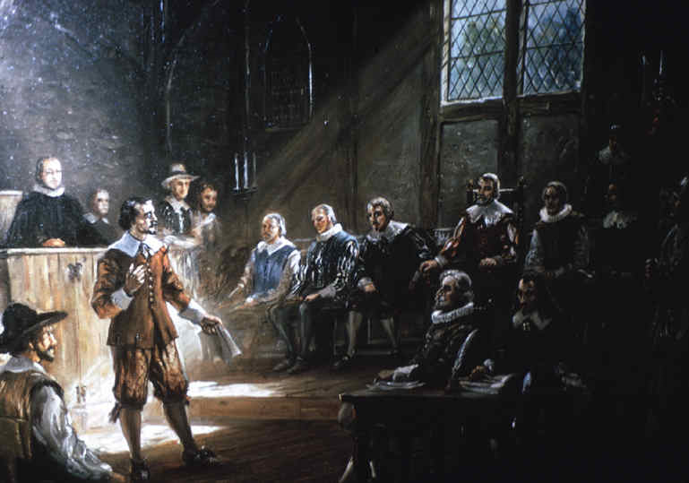
System of Government
In 1619, the governor of Virginia called a meeting of the Virginia Assembly.
The Assembly included two citizen representatives (called “burgesses”)
from each of the divisions of Virginia, the governor’s council, and the governor.
(At that time, only adult men were considered citizens.)

Slide 3
By the 1640’s, the burgesses became a separate legislative body, called the Virginia House of Burgesses.

Slide 4
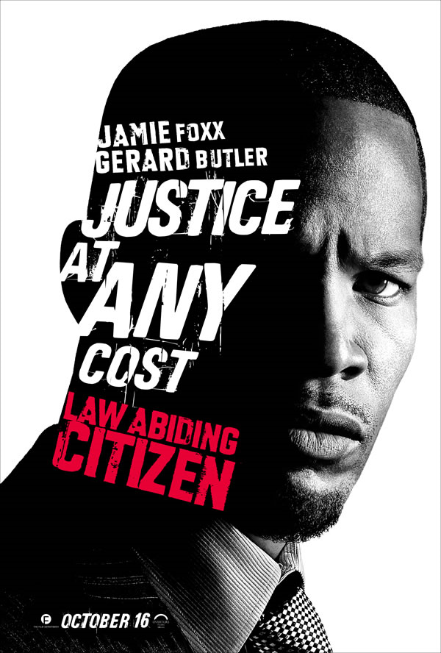
Another word for Burgess…
CITIZEN

Slide 5

Virginia House of Burgesses
The Virginia House of Burgesses was the first elected legislative body in America giving settlers the opportunity to control their own government.

Slide 6
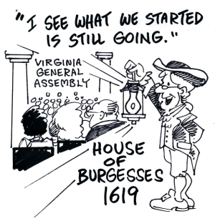
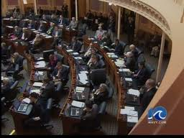
Virginia House of Burgesses
It became the General Assembly of Virginia, which continues to this day.

Slide 7
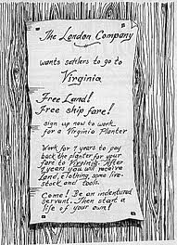
Indentured Servants were men, women and children of both African descent and from the poor white class in England that were brought to the Americas where they were purchased by “free” colonists (both Black & White) to work as a “servant” for a certain period of time.

Slide 8
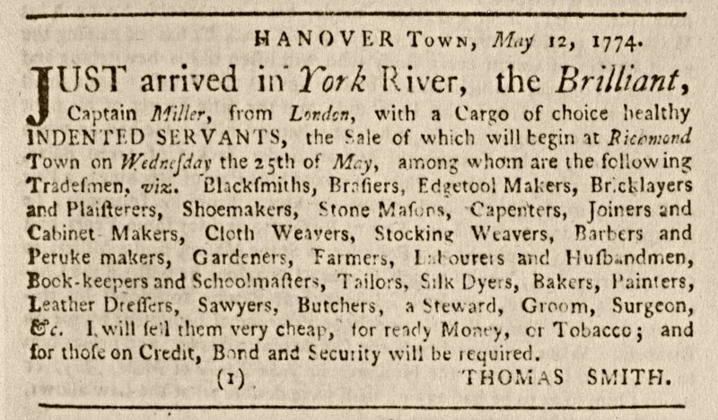
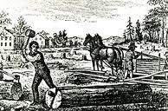
Indentured Servants
As servants, they were housed and fed by their employers until they had completed their contract of service. (Usually 7 years)

Slide 9
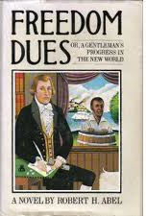

Indentured Servants
Once their term had been served, indentured servants were given their "freedom dues," which usually included:
  Land
  Supplies
  Gun

Slide 10

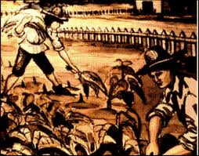
Indentured Servants
Black-skinned or white-skinned, they became free. They had worked off their debt and could now go and start a new life of their choosing in America.

Slide 11

Indenture Agreement
Indenture Agreement
This indenture made the ____________day of ____________________ in the eighth yeere of our Soveraigne King James, etc.
___________________________ doth promise to the Virginia Company to serve fro the day of the date hereof until his arrival in Virginia, and after during the terme of ___________years in such service as the Virginia Company shall imploy him.
In consideration whereof, the Virginia Company doth promise to pay for his passage, and find him Meat, Drinke, Apparelle and Lodging with other necessaries. And at the end of the terme to give him one whole yeere of corne.
In Witness thereof, ___________________________________hath put his hand and seale.

Slide 12
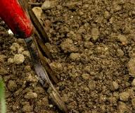
Problems with Indentured Servitude
After the indenture was complete, they got their land, tools, and gun – but the land they got was in rocky soil and on the outskirts of the colony.

Slide 13

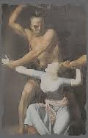
Problems with Indentured Servitude
This meant that the farmers were vulnerable to Indian attacks and couldn’t plant very easily.
They begged for the help of rich planters, but nothing was done.

Slide 14
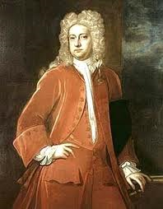
Problems with Indentured Servitude
They were sick of this problem and were fed up with Virginia’s governor, William Berkeley, who they thought was being too pro-Indian.

Slide 15
Bacon’s Rebellion
Nathaniel Bacon’s mob storms the Virginia capitol building and burns it, causing the governor to flee the colony.
Indentured servants both black and white joined the frontier rebellion. Seeing them united in a cause alarmed the ruling class.

Slide 16
Rebellion’s Significance
. After the rebellion, planters didn’t use black indentured servants anymore and instead only had black slaves.
In this way, planters hoped that indentured servants would align with the white planter class instead of slaves because the indentured servants wouldn’t want to associate with slaves.

Slide 17
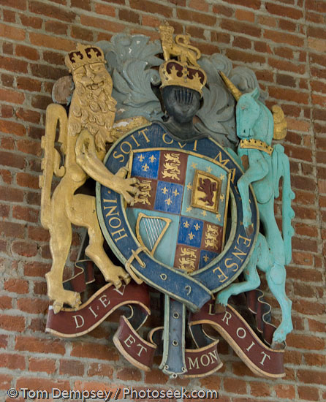
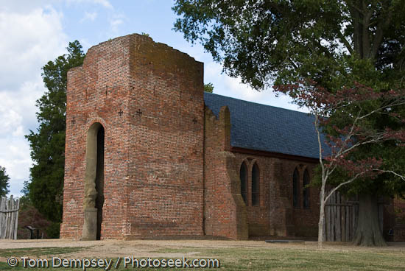
Jamestown Coat of Arms
The coat features both the motto of the English monarchy, "Dieu at mon droit" ("God and my right"), and also the motto of the order of Knighthood, "Honi soit qui mal y pense" ("Shamed be he who thinks evil of it").
Jamestown Coat of Arms
Hanging on the wall in Memorial Church
Memorial Church: Built 1637

Slide 18


Create Your OWN COAT OF ARMS
What are some of your family hobbies?
WHAT THINGS DESCRIBE YOUR FAMILY?
Is there a saying that represents you family best?
What do you guys say to each other all the time?

