Slide 1
Native Americans
Unit 2: Part I

Slide 2
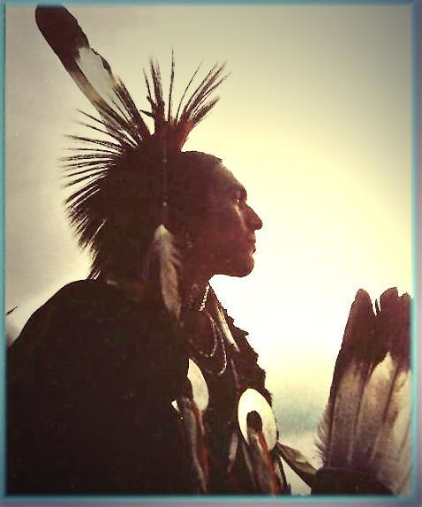
Essential Understanding
Students will explore the myths and realities of life among various Native American Nations in North America prior to exploration of the New World

Slide 3
Stereotypes
How are Native Americans viewed in the media?

Slide 4
Declaration of Independence
…He has excited domestic insurrections amongst us, and has endeavoured to bring on the inhabitants of our frontiers, the merciless Indian Savages, whose known rule of warfare, is an undistinguished destruction of all ages, sexes and conditions.
From the beginning there were negative stereotypes…
Why do you think Thomas Jefferson used the terms
“Merciless” and “Savages” to refer to the Native Americans?
What does this show about Native American and Colonial
relations?

Slide 5
Definition
Stereotypes: fixed impressions, exaggerated or preconceived ideas about particular social groups, usually based solely on physical appearance.
Define Stereotypes in your own words. Give an example of stereotyping in our school or community. Explain your answer.

Slide 6
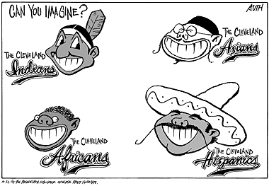

Slide 7
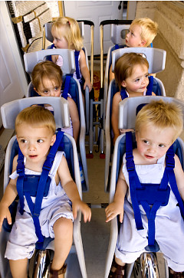
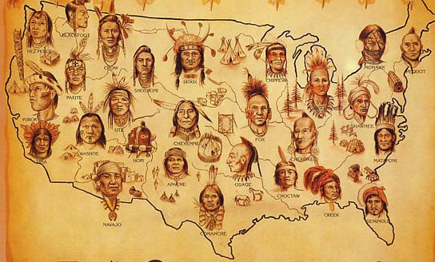
Stereotypes:
Stereotypes Realties
1. Native Americans are all alike.
There are 520 culturally distinct tribes.

Slide 8
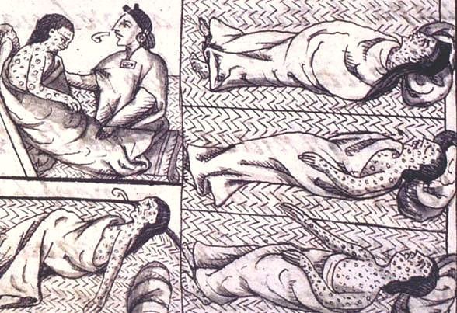
Stereotypes:
2. Native Americans were conquered because they were inferior.
Stereotypes Realties
Conquered because of lack of immunity to diseases.

Slide 9
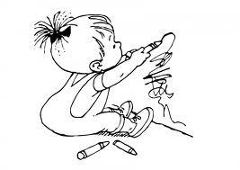
Stereotypes:
Stereotypes Realties
Native Americans civilized; cultures were different than European culture.
3. Native Americans were not civilized until Europeans came.

Slide 10
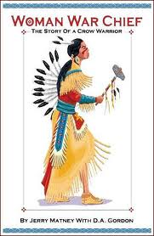
Stereotypes:
Stereotypes Realties
4. All Native Americans did not value or empower women.
In some Native cultures, women often wielded considerable power.

Slide 11
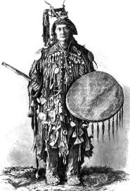
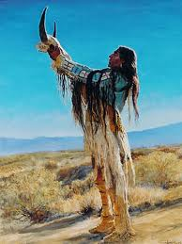
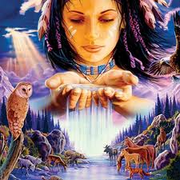
Stereotypes:
Stereotypes Realties
5. Native Americans had no religion.
Deeply religious; own religions.

Slide 12
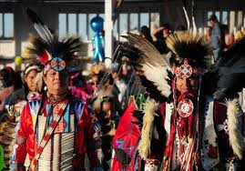
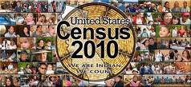
Stereotypes:
Stereotypes Realties
6. Native Americans are a vanished race.
3 million by 2010 census.

Slide 13
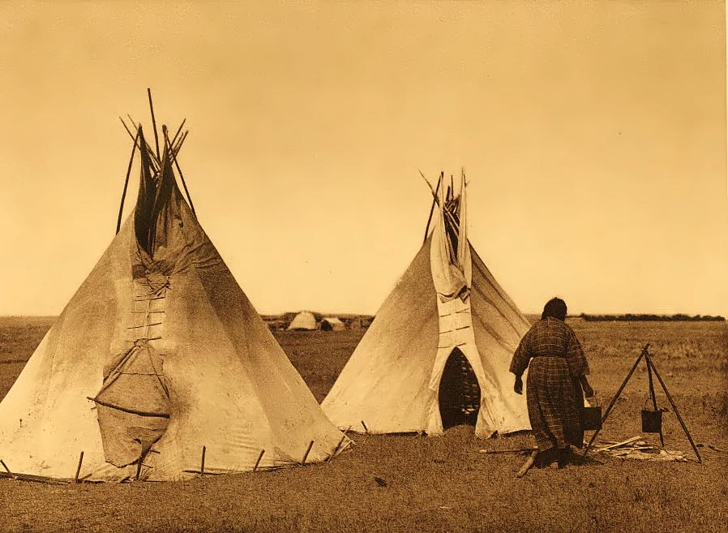
Stereotypes:
Stereotypes Realties
Not confined to reservations; few wear braids, ride horses, live in teepees (tipis).
7. Native Americans are confined to reservations, live in tipis, wear braids, and ride horses.

Slide 14
Stereotypes:
Stereotypes Realties
8. Native Americans know the histories, languages, and cultural aspects of their own tribe and all other tribes.
Few know all the info on their own tribe, let alone all of the others.

Slide 15
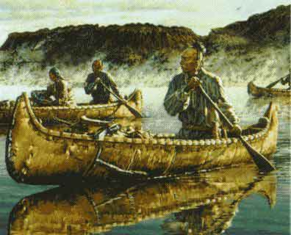
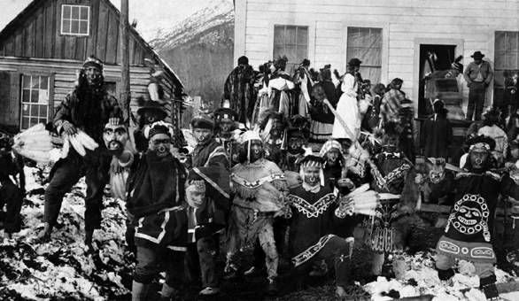
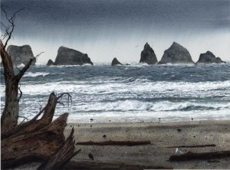
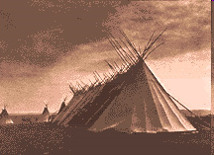
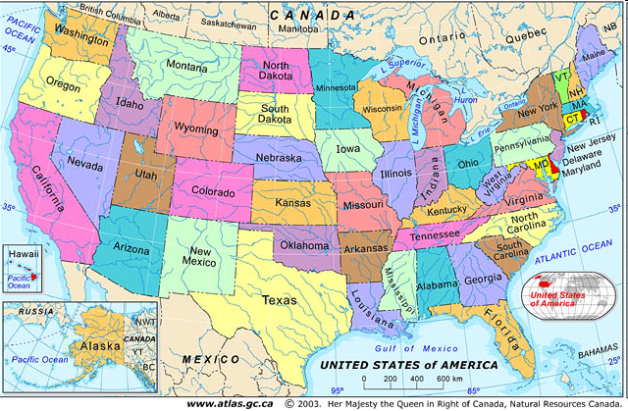
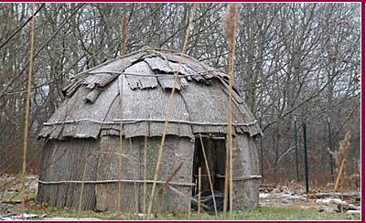
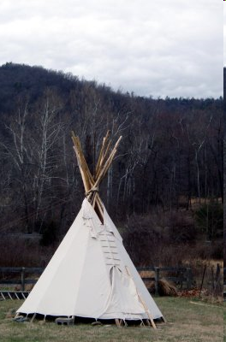
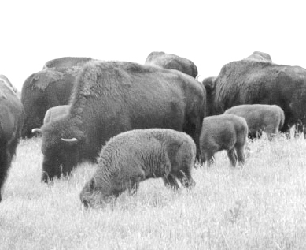
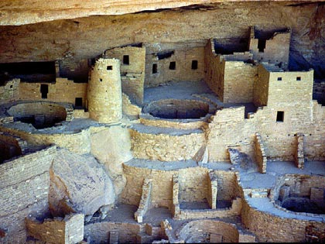
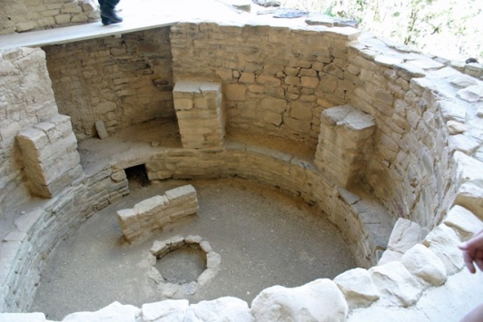
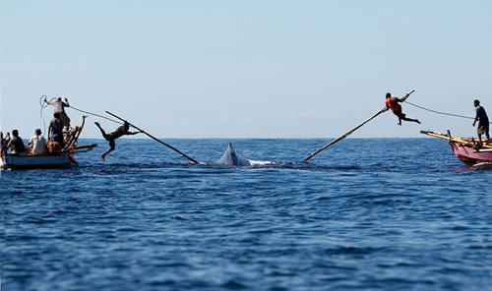
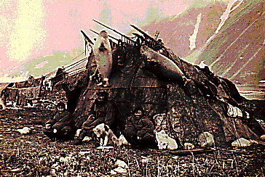
Northwest Coastal
Eastern Woodland
Plains
Southwest
Inuit

