Slide 1
Pilgrims

Slide 2
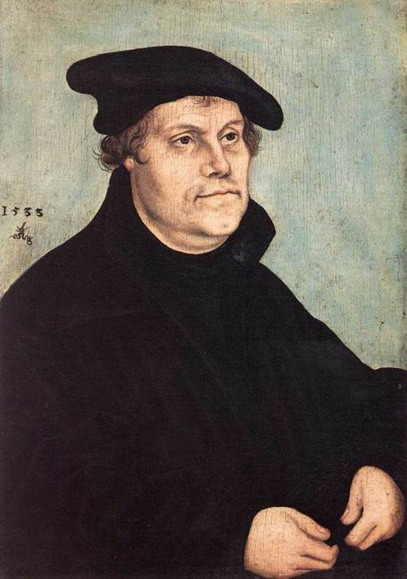
Who was Martin Luther?
He split from the Catholic Church and began what we call the Protestant Reformation

Slide 3
Religious tension remained high after the Protestant Reformation and many individual religious groups formed.

Slide 4
One protestant group called the Puritans wanted to reform, or purify, the Church of England. They believed that the Bible, and not the King, should be the source of religious authority.

Slide 5
What is a Separatist?
The most extreme group of Puritans wanted to cut all ties with the Church of England. They became known as Separatists. In response, English leaders began to punish Separatists.

Slide 6
Pilgrims
One group of Separatists who faced such treatment became known as the Pilgrims. In 1608 the Pilgrims left England to escape this persecution and moved to the Netherlands.

Slide 7
Dutch officials welcomed the Pilgrims and allowed them to practice their religion freely, but the Pilgrims were afraid that Dutch society was corrupting their children.

Slide 8
The Pilgrims decided to leave the Netherlands and return to England to ask for permission to settle in a far off land called Virginia.

Slide 9
They were given permission and on September 16, 1620, a ship called the Mayflower left England with more than 100 men, women, and children aboard.

Slide 10
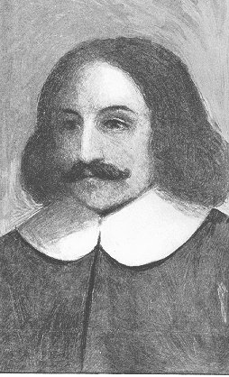
A man named William Bradford was in charge.

Slide 11
The Trip Over
After two months of rough ocean travel the Pilgrims sighted land. Soon they realized that storms at Sea had blown them far off course.

Slide 12
They were far North of Virginia
and therefore outside the
boundaries of their English charter.

Slide 13
They decided to settle where they had landed.

Slide 14
Mayflower Compact
The Pilgrims wanted their colony to have basic laws and social rules and so on November 21, 1620, 41 of the male passengers on board the Mayflower signed a legal contract. They called this contract the Mayflower compact.

Slide 15
In it they agreed to have fair
laws to protest the general
good. This was one of the first
attempt at self government in
the English colonies.

Slide 16
Mayflower Compact Activity

Slide 17
Sources
http://www.cartoonstock.com/vintage/directory/p/puritans_gifts.asp
http://www.life.com/image/53370603
http://forums.malwarebytes.org/index.php?showtopic=45664&st=0&p=227039&#entry227039
http://www.corbisimages.com/Enlargement/HU062096.html
http://endtimepilgrim.org/puritans03.htm
http://mises.org/daily/2395
http://www.boerner.net/jboerner/?page&paged=74
http://thedeliberateagrarian.blogspot.com/2005/11/pilgrims-christian-agrarian-exodus-of.html
http://www.myspace.com/katiebabsrocks/comments
http://io9.com/5413099/where-are-all-the-space-pilgrims
http://endtimepilgrim.org/puritans11.htm
http://connect.in.com/ships/photos-great-ships-csg005-the-mayflower-9ee7736070d7e1e0.html
http://www.gutenberg.org/files/4107/4107-h/4107-h.htm
http://granitegrok.com/blog/2008/11/
http://www.best-rate.com/
http://www.executedtoday.com/2008/09/04/1638-three-of-four-english-colonists-for-murdering-a-native-american/
http://englishcoloniesc1.blogspot.com/
http://www.st-teresas.org.uk/Churches_Together.htm

