Slide 1
Puritans
Colonial America

Slide 2
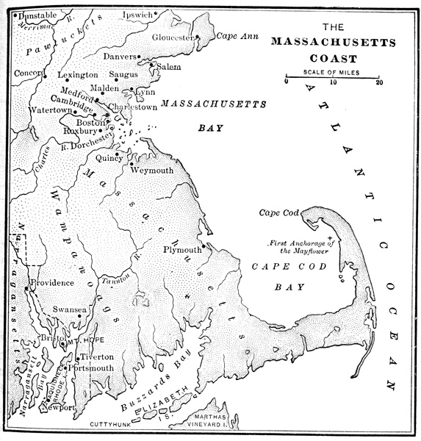
Plymouth and Mass Bay Colony

Slide 3
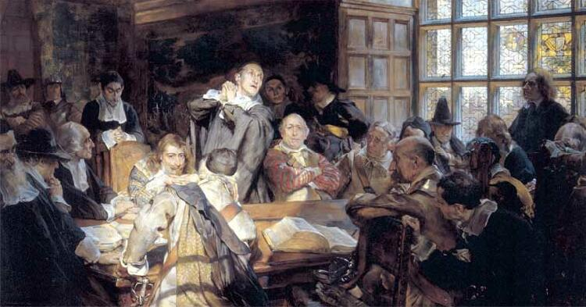
1
What do you know about the Puritans based on this picture?

Slide 4
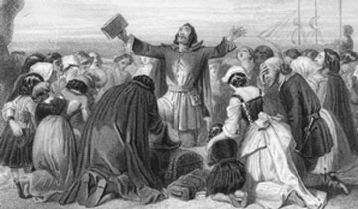
2
What do you know about Puritans based on this picture?

Slide 5
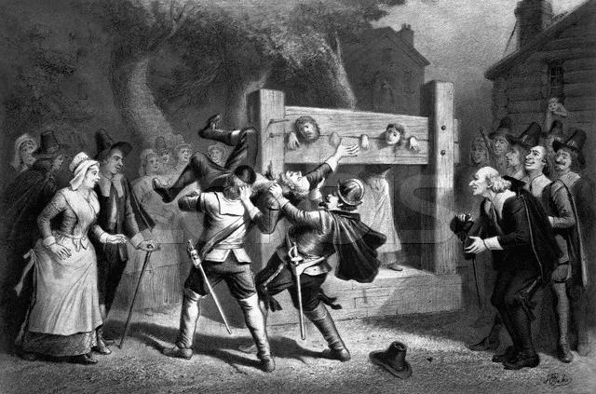
3
What do you know about Puritans based on this picture?

Slide 6
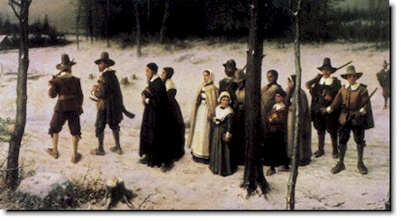
4
What do you notice about Puritans in this picture?

Slide 7
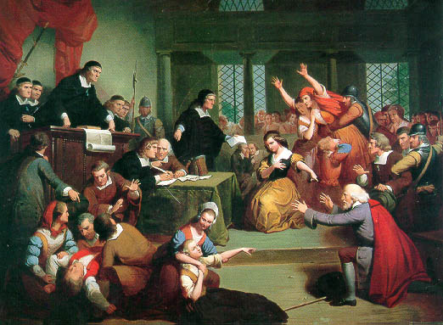
5
What can you infer about the Puritans from this picture?

Slide 8
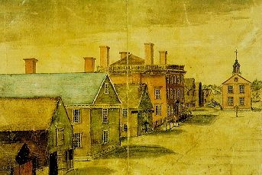
6
This is a picture of Salem Village around 1692. What conclusions can you draw based on what you see in this picture?

Slide 9
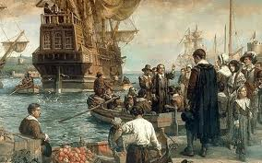
Background
In the 1620’s the Church of England began to punish Puritans because they were dissenters. Dissenters are People who disagree with official opinions.
Many Puritans began to look elsewhere for a place to practice their religion in peace. In 1630 a fleet of ships carrying Puritan colonists left England for Massachusetts. There they hoped to have the freedom to practice their religion freely.

Slide 10
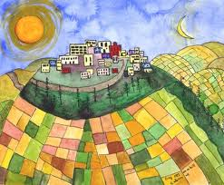
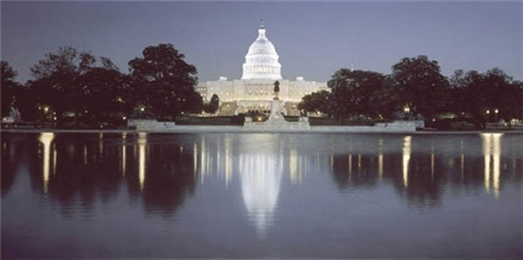
John Winthrop, a leader of the Puritans, wrote about the Puritans’ goals:
“We must delight in each other, make others’ conditions our own and rejoice together, mourn together, labor and suffer together, always having before our eyes… our community….For we must consider that we shall be like a City upon a Hill; the eyes of all people are on us.”
Winthrop’s speech reflected the Puritans’ belief that they were destined to build an ideal Christians community.

Slide 11
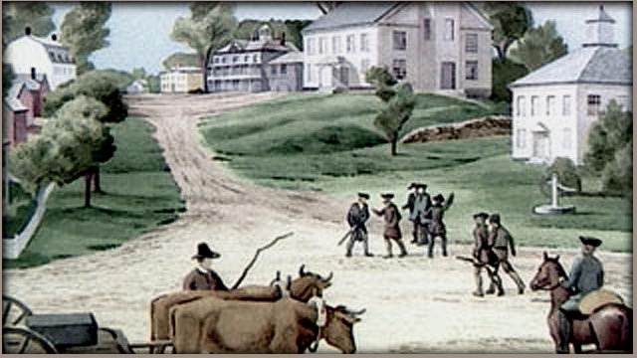
Five Basic Beliefs
Man is sinful
Man can’t save himself
God chooses people to be saved
God’s grace saves – not their actions
Once saved – always saved

Slide 12
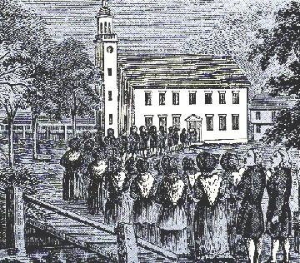
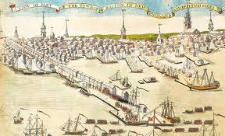
Background
Between 1630 and 1640 tens of thousands of English men, women, and children moved to colonies in New England.
The Puritans arrived in New England well prepared to start their colony. They brought large numbers of tools and livestock. Trade with the colony of Plymouth helped them too. The Massachusetts region, unlike coastal Virginia, had a healthy climate. Thus, few Puritans died from sickness.
Puritans established the towns of Salem, Mystic, Newton, Watertown, and Dorchester. In addition , they built Boston, which became the colony’s chief city and capital.

Slide 13
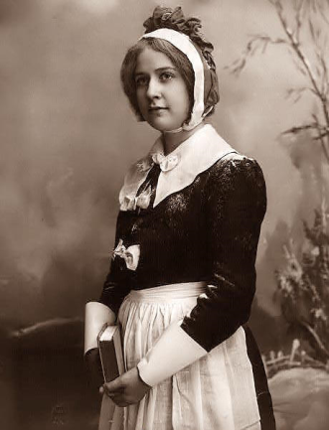
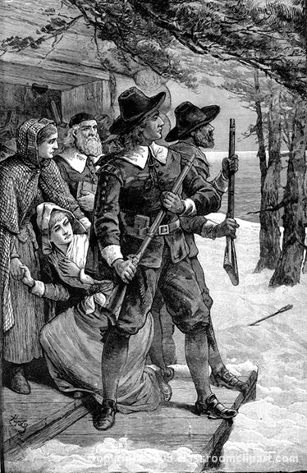
Daily Life
New England colonists’ lives centered around religion, family duties and public work.
New England farmers grew food mainly for their own use rather than crops like tobacco for sale. Most New England farms were owned and run entirely by families.
These small farms did not bring great wealth to their owners but also did not need as many laborers as did the southern plantations. There was little need for indentured servants or slaves in New England.

Slide 14
System of Government
The company charter created a General Court to help run the colony. This body was a type of self government that was composed of two or three delegates from each town.
Government and religion were closely linked in Puritan society. Government leaders were also church members. Male church members were the only colonists who could vote.

Slide 15
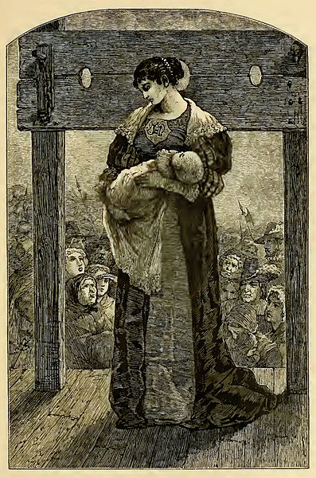
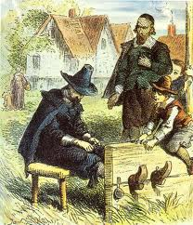
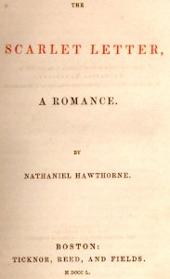
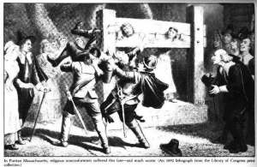
Puritan Discipline

Slide 16
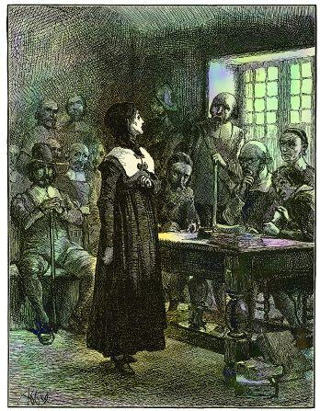
Discontent
Not all Puritans were happy with the way things were run in Massachusetts.
In Boston, Anne Hutchinson angered Puritan church leaders by publicly discussing religious ideas that some leaders thought radical. For example, she claimed that God could speak directly to people rather than just through the Bible.
Puritan leader such as John Winthrop were alarmed by Hutchinson’s views and put her on trial. She was banished from the colony and she and her followers went to live in Rhode Island.

Slide 18
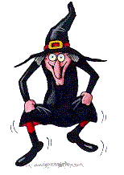
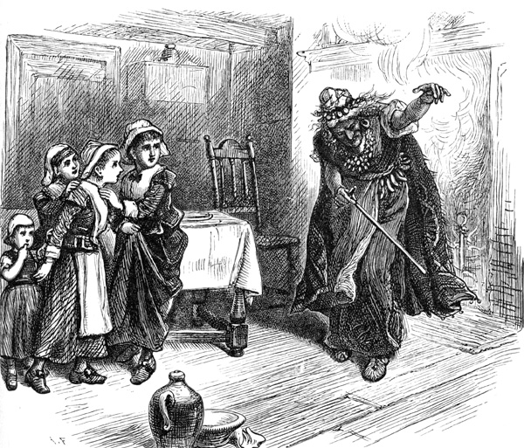
Salem Witch Trial
Perhaps the worst community conflicts in New England involved the witchcraft trials of the early 1690’s. The largest number of trials were held in Salem, Massachusetts.
In Salem, a group of girls had accused people of casting spells on them. The community formed a special court to judge the witchcraft cases. The court often pressured the suspected witches to confess.
The Salem witch trials led to 19 people being put to death. By the next year, many of the local officials and clergymen involved regretted their acts.

