Slide 1
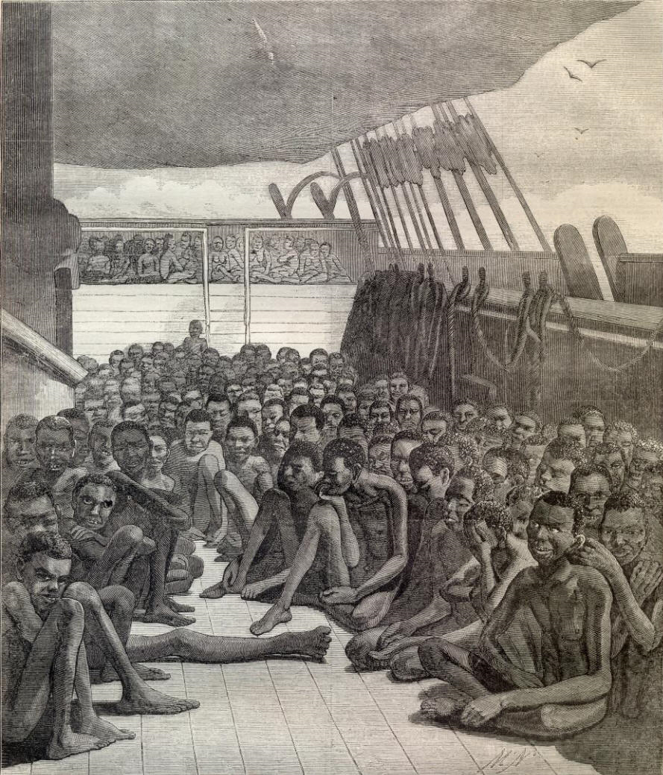
Slave Trade
Triangle Trade

Slide 2
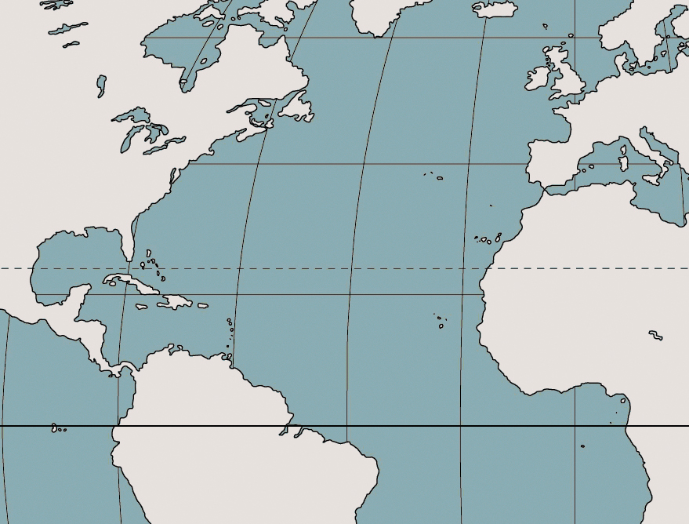
What was the Triangular Trade?
Click here to begin Quiz…..

Slide 3
The Triangular Trade was a trade route between three different places. What were they?
Click on one of the places

Slide 4
Incorrect.
Click Here to return.

Slide 5
Correct.
Click here for your next question.
Europe
The
Caribbean Islands
Africa

Slide 6
Which journey was known as the middle passage?
Click the letter….
Europe
A
B
The
Caribbean Islands
C
Africa

Slide 7
Incorrect.
Click Here to return.

Slide 8
Correct.
Click here for your next question.
Europe
The
Caribbean Islands
Middle Passage
Africa

Slide 9
What was carried on the ships sailing from Africa to the Caribbean?
Click the answer….
Europe
The
Caribbean Islands
Middle Passage
Africa
Manufactured Goods
Enslaved People
Raw Materials

Slide 10
Incorrect.
Click Here to return.

Slide 11
Correct.
Click here for the next question.
Europe
‘Never can so much misery be found condensed in so small a place as in a slave ship during the middle passage’ William Wilberforce
The
Caribbean Islands
Middle Passage
Africa
Enslaved Africans
“This trade was so considerable that, while it was in a flourishing state, there were above 20,000 Negroes yearly exported from Guinea Coast.” Captain William Snelgrave 1754

Slide 12
Which journey was known as the outward passage?
Click the letter….
Europe
A
B
The
Caribbean Islands
C
Africa

Slide 13
Incorrect.
Click Here to return.

Slide 14
Correct.
Click here for the next question.
Europe
Outward Passage
Ships known as ‘slavers’ left British ports such as London, Bristol and Liverpool for West Africa loaded with trade goods. These would include guns, gunpowder and ammunition, brass and ironware, alcohol, cotton cloth, glass beads and trinkets.
.
The
Caribbean Islands
Middle Passage
Africa

Slide 15
What was carried on the ships sailing from Europe to Africa?
Click the answer….
Europe
Outward Passage
The
Caribbean Islands
Middle Passage
Africa
Manufactured Goods
Enslaved People
Raw Materials

Slide 16
Incorrect.
Click Here to return.

Slide 17
Correct.
Click here for the next question.
Europe
Manufactured Goods
Outward Passage
The
Caribbean Islands
Middle Passage
Africa
Enslaved Africans

Slide 18
Which journey was known as the Homeward Passage?
Click the letter….
Europe
A
B
The
Caribbean Islands
C
Africa

Slide 19
Incorrect.
Click Here to return.

Slide 20
Correct.
Click here for the next question.
Europe
Homeward Passage
Outward Passage
The
Caribbean Islands
Middle Passage
Africa

Slide 21
What was carried on the ships sailing from The Caribbean to Europe?
Click the answer….
Europe
Homeward Passage
Outward Passage
The
Caribbean Islands
Middle Passage
Africa
Manufactured Goods
Enslaved People
Raw Materials

Slide 22
Incorrect.
Click Here to return.

Slide 23
Correct.
Click here.
Europe
Raw Materials
Homeward Passage
Manufactured Goods
Outward Passage
The
Caribbean Islands
Middle Passage
Africa
Enslaved Africans
In 1783 the Pinney’s Mountravers plantation on the island of Nevis was producing about 30,000 kg of sugar a year and 33,000 litres of rum.

Slide 24
The hard labour of enslaved Africans led to great wealth and riches for European countries, particularly Britain which traded in sugar, tobacco and cotton produced by slaves on plantations. .
Europe
Raw Materials
Homeward Passage
Manufactured Goods
Outward Passage
The
Caribbean Islands
Middle Passage
Africa
Enslaved Africans

Slide 25
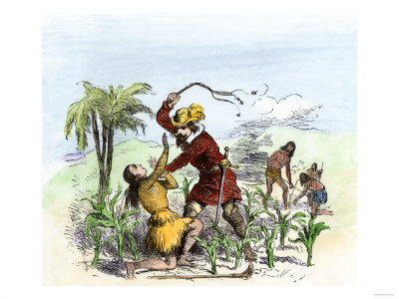
How did the Slave Trade Begin?
Portuguese
  Prince Henry sent men to discover the world.
  They built a fort in North Africa and started sending Africans to Brazil to work as slaves.
Spanish
  When the Spanish conquered much of South America and the Indies, Africans were sent to work as slaves on the plantations.

Slide 26
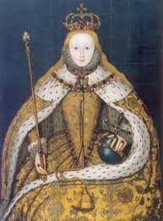
How did the Slave Trade Begin?
English
  Queen Elizabeth was persuaded by English explorers to begin the trade in 1616

Slide 27
STAGE 1
Ships left Europe loaded with goods, such as guns, tools, textiles & rum.
Crews with guns went ashore to capture slaves.

Slide 28
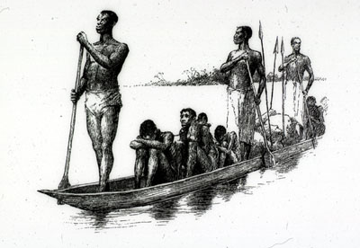
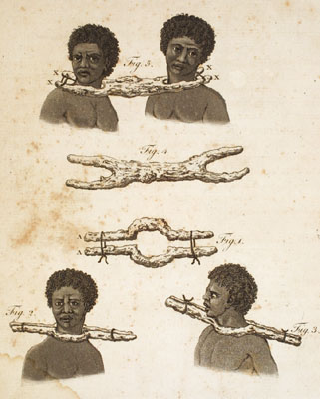
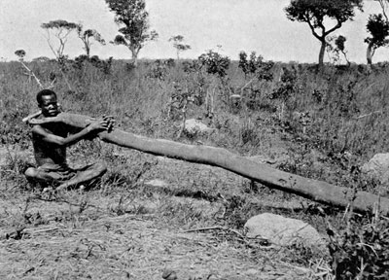
Slaves were obtained by:
  Kidnapping
  Trading
  People were given by chiefs as tributes (gifts)
  Chiefs would send people who were in debt
  Chiefs would send criminals through judicial process
  Prisoners of tribal wars were also sent.

Slide 29
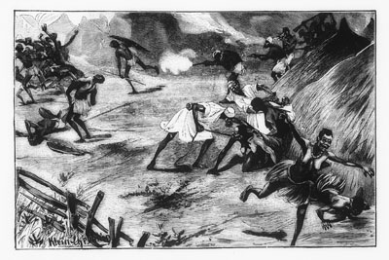
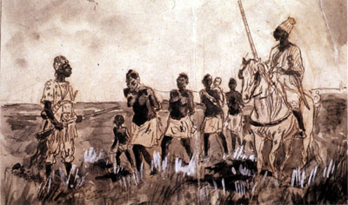
Forced Participation
African Chiefs did resist in the beginning; however, they needed weapons for defence.
The Europeans were too powerful; therefore, any effort to resistance was unsuccessful
If chiefs didn’t supply slaves, they were threatened to be taken as slaves.

Slide 30
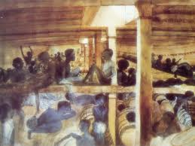
STAGE 2
Africans would be put on the ships in chains and would sail to the Indies or American colonies.

Slide 31
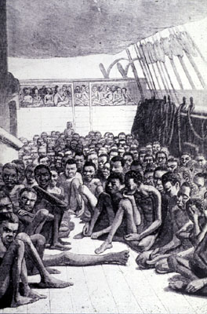
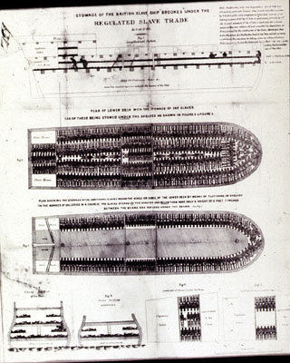
“Loose packing” meant that the captains would take on board fewer slaves in hope to reduce sickness and death.
“Tight packing” meant that the captains would carry as many slaves as their ship could hold, as they believed that many blacks would die on the voyage anyway

Slide 32
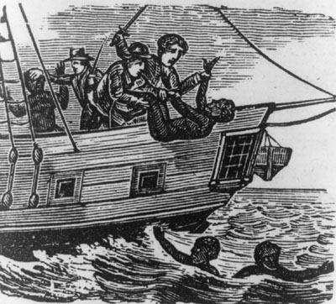
In some tribes, Africans believed that if they died, their spirit would go back to rest in Africa so some would purposefully throw themselves overboard hoping to die and go home to Africa.

Slide 33
STAGE 3
Africans would be sold at auctions in the Americas
The ships’ captains would use the $ from their sale to buy a 3rd cargo of raw materials: sugar, spices or tobacco.
They sold this for a further large profit in Europe.
In Europe, they would convert the raw materials into finished product.

Slide 34
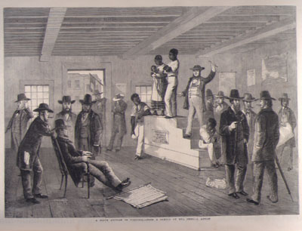
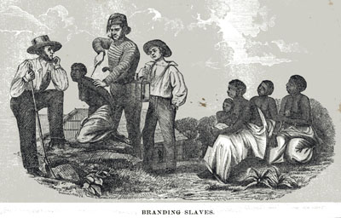
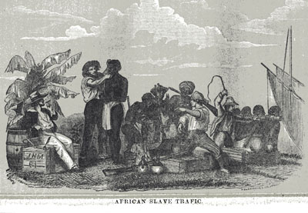
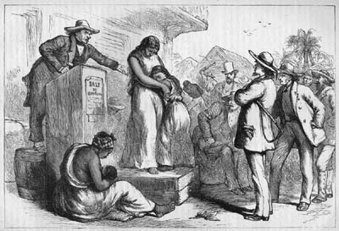

Slide 35
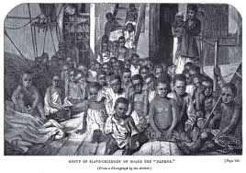
Over 10,000,000 slaves were taken to North and South America between the 1500s and the 1800s.

