Slide 1
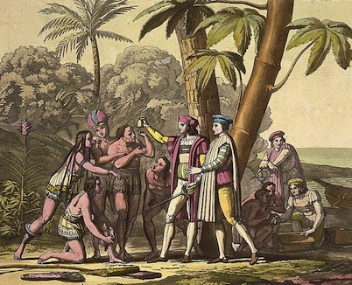
The Columbian Exchange

Slide 2
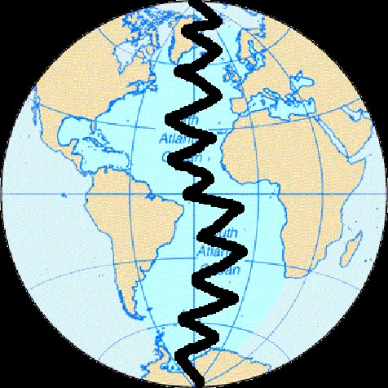
Before 1492
N
E
W
W
O
R
L
D
O
L
D
W
O
R
L
D
Notes:
Before Columbus crossed the Atlantic, the Eastern Hemisphere (that is Europe, Africa and Asia) and the Western Hemisphere (that is the Americas) were two very different ecosystems. These ecosystems had been developing in biological isolation for thousand and thousand of years. This meant that there were two different disease pools and two sets of flora and fauna, as well as two sets of culturally diverse peoples.

Slide 3
What is an exchange? What does that mean?
Exploration led to an enormous exchange of people, plants, animals, technology and ideas that would change the lives of people in Asia, Europe, the Americas and Africa.

Slide 4
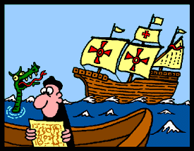
Because this global exchange began with Columbus, it is called the Columbian Exchange.

Slide 5
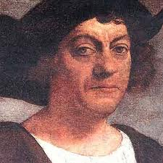
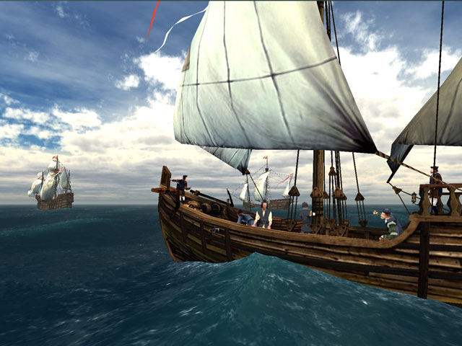
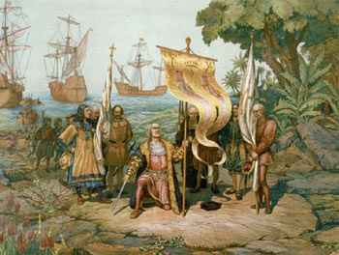
“...all the trees were as different from ours as day from night, and so the fruits, the herbage, the rocks, and all things.”
-- Christopher Columbus

Slide 6
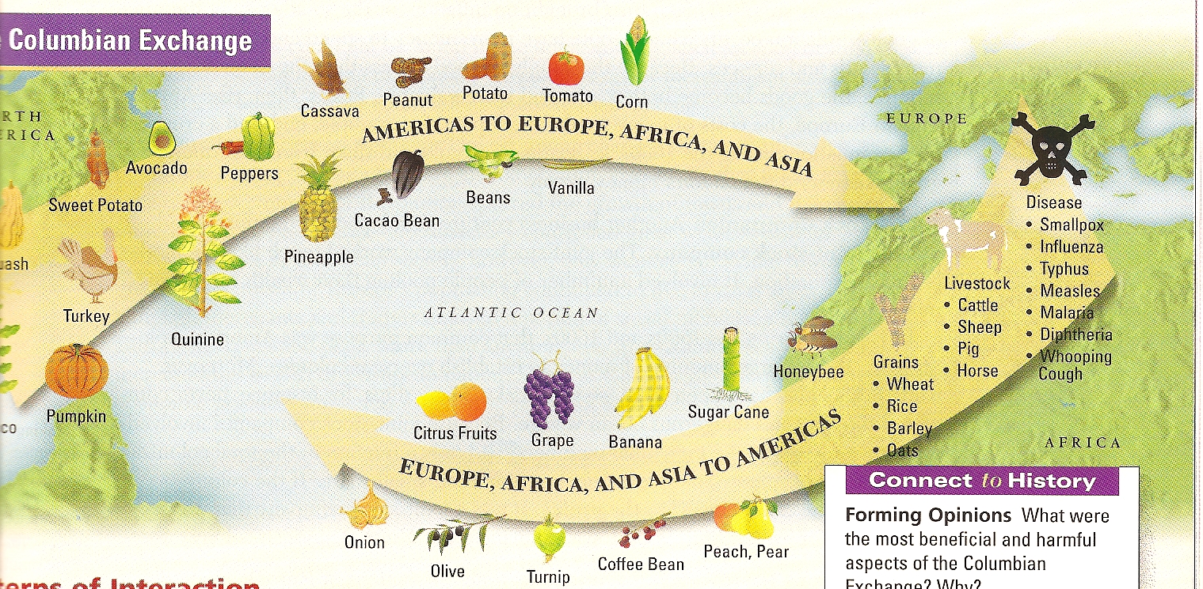

Slide 7
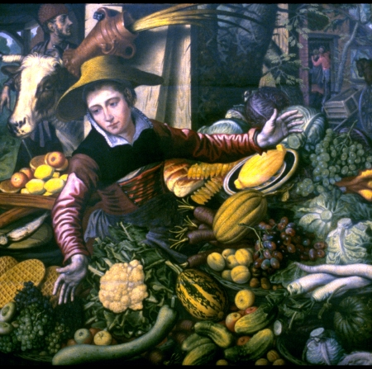
What does this painting tell you about the effects of the Columbian Exchange on the European diet?

