Slide 1
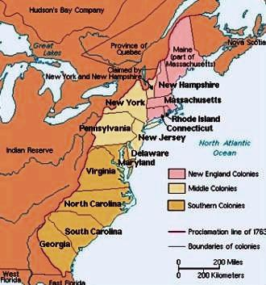

Slide 2
The Founders
Colonial America

Slide 3
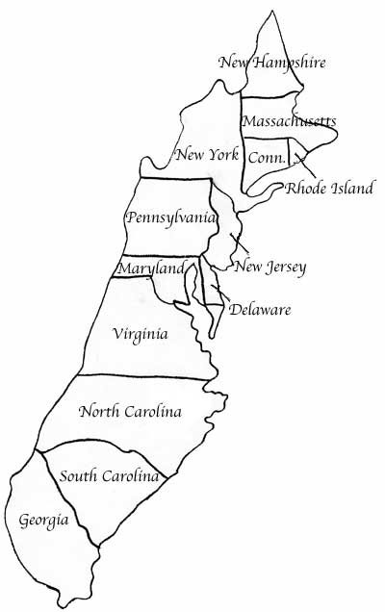
John Winthrop
Thomas Hooker
The Founders
Roger Williams
William Penn
Cecelius Calvert
James Oglethorpe

Slide 4
Staple-less Book
Get out the scissors
Make the book
John Winthrop pg. 104
Thomas Hooker pg. 105
Roger Williams pg. 107
Cecilius Calvert pg. 110
William Penn pg. 113
James Oglethorpe pg. 114

Slide 5
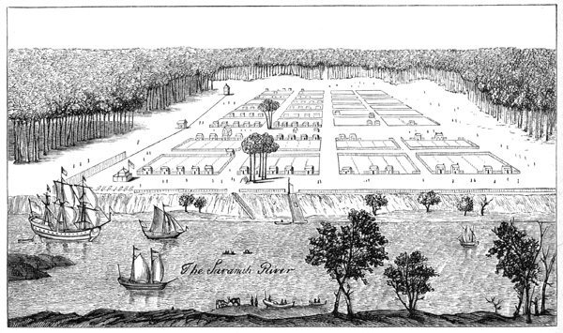
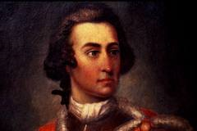
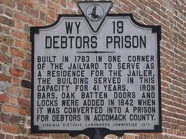
James Oglethorpe
Who: Granted a charter to start a colony for poor English people and those who’d been jailed for unpaid debts.
Where: Georgia – the shield between South Carolina and Spanish Florida
Really? That Interesting!: Oglethorpe didn’t want big plantations but small farms. He outlawed slavery and limited size of land grants. That didn’t last long.

Slide 6
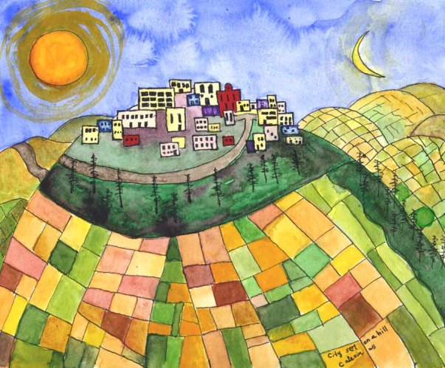
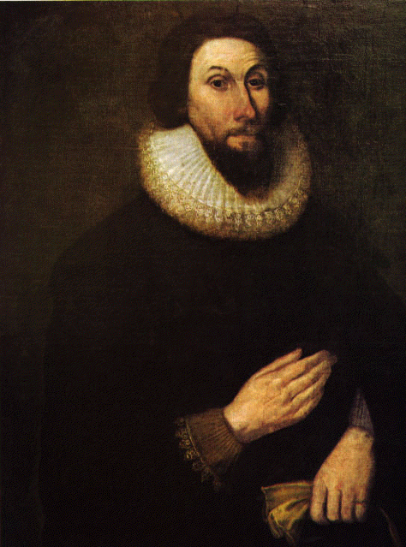
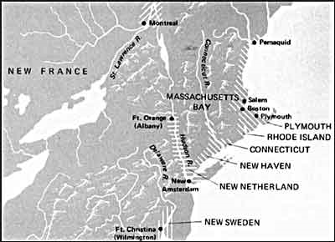
John Winthrop
Who: Colony’s Governor
Where: Massachusetts Bay Colony
Really? That Interesting!: Winthrop thought that Mass. Bay Colony should be like a “City on a Hill.”

Slide 7
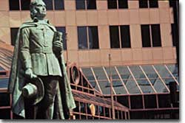
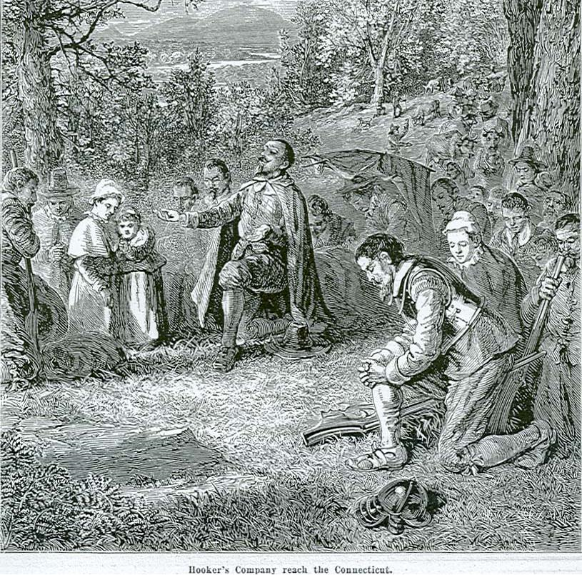
Thomas Hooker
Who: A minister who left Massachusetts
Where: Founded Connecticut
Really? That Interesting!: Drafted the Fundamental Orders of Connecticut, which made the colony more democratic. For example, if a man was not a church member, he could still vote. Hooker is called, “the father of American democracy.”

Slide 8
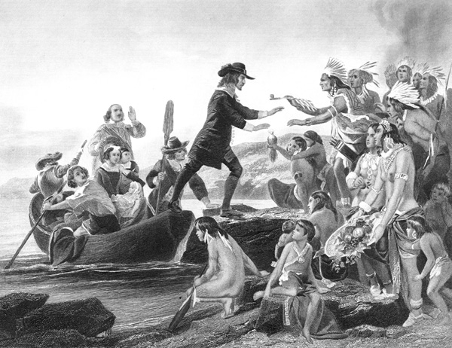
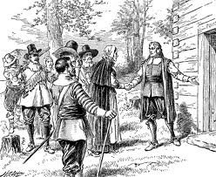
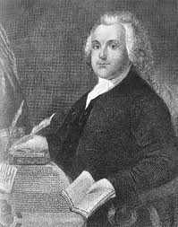
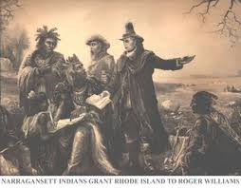
Roger Williams
Who: Didn’t agree with Puritan ideals or the way they took land from the Indians. He was kicked out of Massachusetts.
Where: Providence, Rhode Island
Really? That Interesting!: Williams supported the separation of church and politics. He encouraged religious tolerance and fair treatment of Indians.

Slide 9
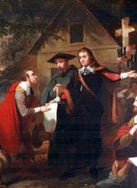
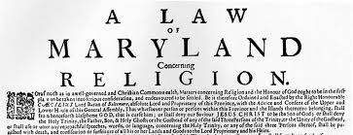
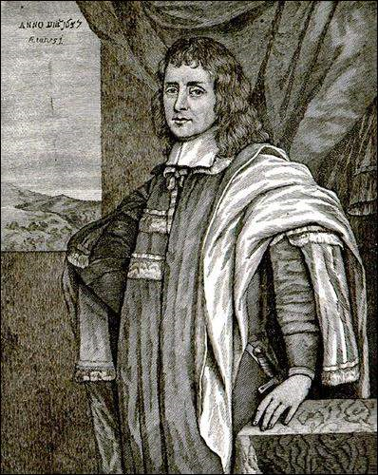
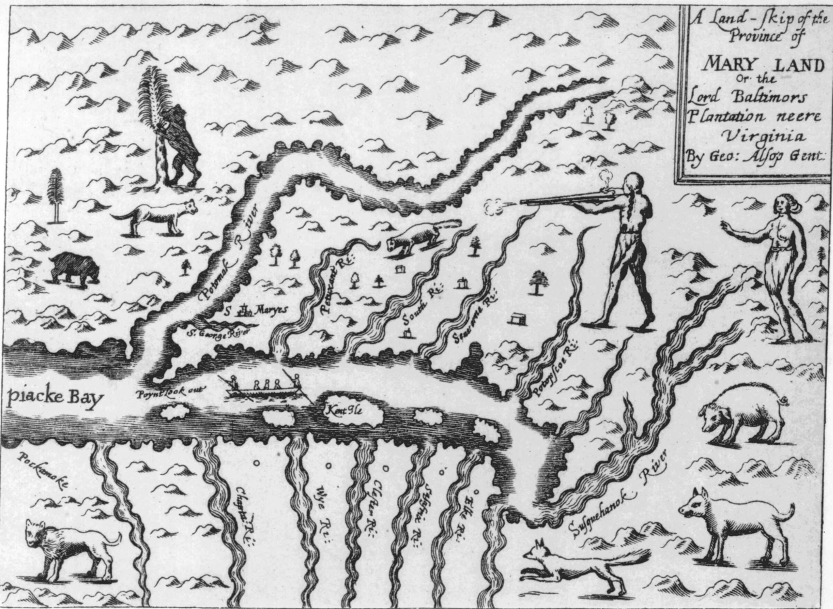
Cecelius Calvert
Who: Given a charter to found a new colony from King Charles I as a refuge for English Catholics
Where: Maryland
Really? That Interesting!: Calvert never visited his own colony because it was a proprietor owned. Baltimore came up with the Toleration Act of 1649 – you can’t take away Christians rights.

Slide 10
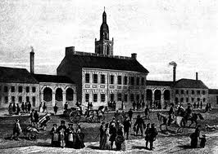
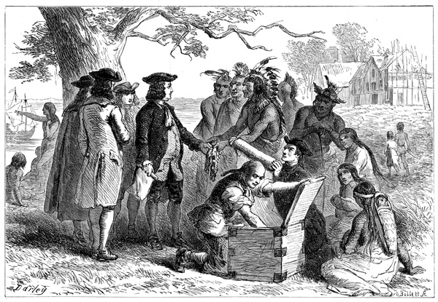
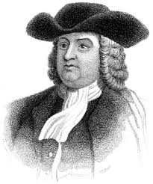
William Penn
Who: A proprietor of New Jersey colony, and a Quaker.
Where: Pennsylvania
Really? That Interesting!: Penn sold land for cheap and promised religious freedom to all Christians. He named the capital Philadelphia, the City of Brotherly Love.

